Slide 1
The State of New Mexico Group Benefits Health Plan Plan Year: January – December 2020
Administered by:
Flexible Spending and Transportation Benefit

Slide 2
Flexible Spending Program
Flexible Spending Accounts (FSA) allow employees to set aside money for eligible expenses prior to taxes being withheld
Health FSA – covers eligible health care expenses
Dependent Care Assistance Program – covers day care for children 12 and under
Transportation/Parking – covers transit and parking expenses incurred traveling to/from work
Deductions are taken from your paycheck before taxes are withheld, reducing your withholding and saving you money

Slide 3
Enrollment
Health Care
Enroll during open enrollment, within 30 days of hire date, or after a Qualifying Event
Covers employee, spouse, and children under age 26
Does not cover domestic partners or children of domestic partners
Dependent Care
Enroll during open enrollment, within 30 days of hire, or after a Qualifying Event
Covers dependent children 12 years old or younger
Transportation/Parking
Enroll or change enrollment at any time
Covers employee expenses only

Slide 4
Open Enrollment 2020
Health and Dependent Care
Transit and Parking
Mandatory Annual Enrollment
In order to participate in FSA for health and/or dependent care in 2020, you must enroll during the open enrollment season, whether or not you were enrolled in 2019
Changing Your Election
Changes to your enrollment outside of open enrollment can only be done during a qualifying event
Rollover Enrollment
If you were enrolled in transit or parking during 2019, your election will automatically carry over into 2020
Changing Your Election
You may enroll or make changes to your transit or parking election at any time during the year

Slide 5
Health Care FSA
Minimum Annual Contribution | $130.00
Maximum Annual Contribution | $2,750.00
Expenses must be incurred within the period January 1, 2020 to March 15, 2021
Claims must be submitted by March 31, 2021 to be approved
Includes a grace period to allow funds to be fully utilized
Use-it-or-lose-it account → Funds left in your count at the end of the filing period will be forfeited
Reimbursements for approved eligible expenses available via:
Debit Card
Online Claim Submission
Paper Claim Submission

Slide 6
Eligible Health Care Expenses
Eligible Expenses
Not Eligible Expenses
Out of pocket medical expenses like copays, coinsurance, and deductibles
Non-cosmetic dental expenses
Vision care expenses
Medically necessary prescriptions
Expenses that aren’t medically necessary
Expenses that have not yet been incurred
Expenses incurred before or after plan enrollment
Expenses incurred after you’ve exhausted your balance
Expenses will be reviewed for eligibility. Claims require a receipt or Explanation of Benefits (EOB) that shows your name, medical provider, the date, the amount, and what service was received.

Slide 7
Dependent Care Assistance Program
Minimum Annual Contribution | $130.00
Maximum Annual Contribution | $5,000.00
Expenses must be incurred within the period January 1, 2020 and December 31, 2020
Claims must be submitted by March 31, 2021 to be approved
Use-it-or-lose-it account → Funds left in your account at the end of the filing period will be forfeited
Reimbursements for approved eligible expenses available via:
Debit Card
Online Claim Submission
Paper Claim Submission

Slide 8
Eligible Dependent Care Expenses
Dependent Care is to help you pay for child care while you and your spouse work or look for work.
Eligible Expenses
Ineligible Expenses
Before/After School Care
Daycare
Summer Camp
Late pick-up fees
Registration fees*
Application fees*
*not reimbursable until care has been provided
Expenses paid to child’s parent or a child under the age of 19
Overnight Camps
Instructional or sport camps
Late payment fees
Educational Expenses

Slide 9
Transportation Reimbursement
Enrollment and changes to elections can occur at any time during the year
Include costs of public or privately operated transit service
Reimbursements for claims available via:
Online Claim Submission
Paper Claim Submission
Mass Transit / Van-Pooling
Transit must be a public or private vehicle that seats at least 6 adults
Maximum contribution: $270/month
Parking at or near your employment
Maximum contribution: $270/month

Slide 10
Debit Card
Available for both Health and Dependent Care
Allows you to pay for qualified expenses directly from your FSA at time of service
May still require additional documentation
Keep receipts and EOBs for all debit card expenses in case of claim review

Slide 11
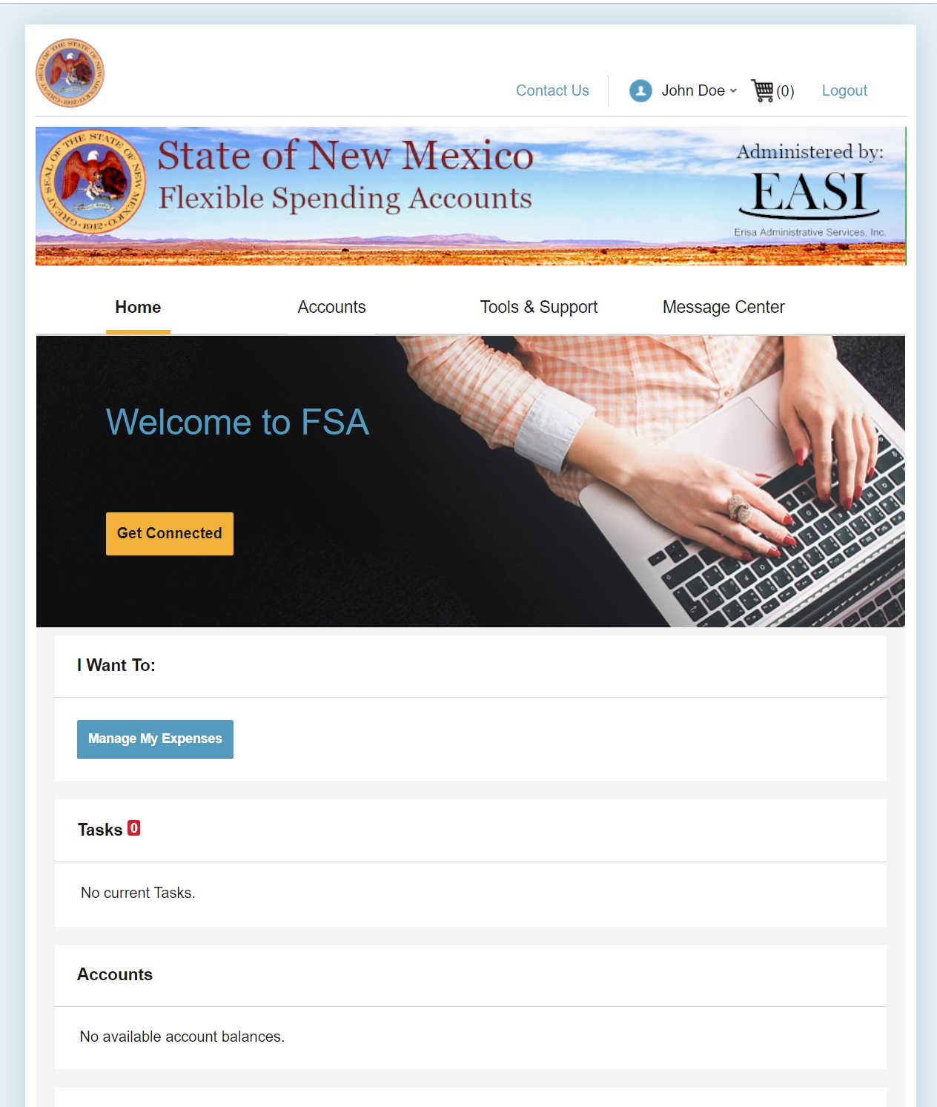
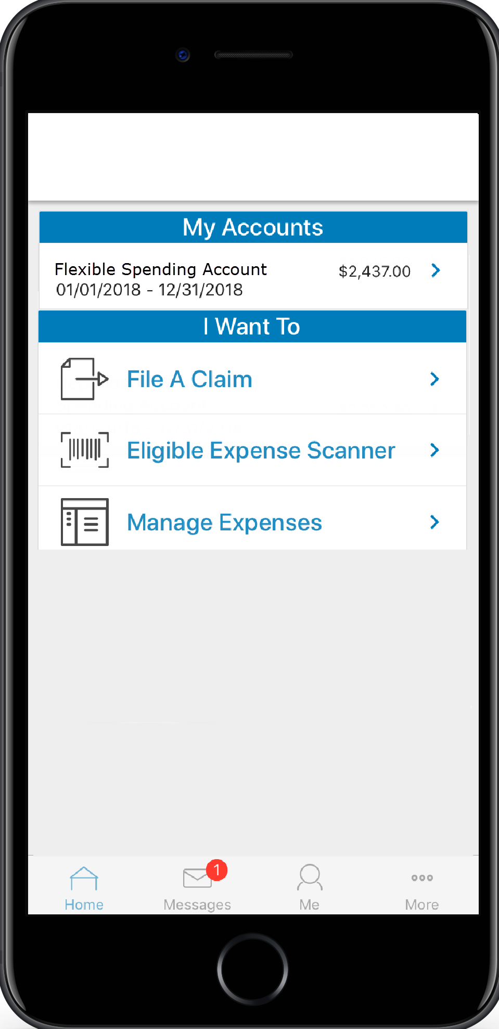
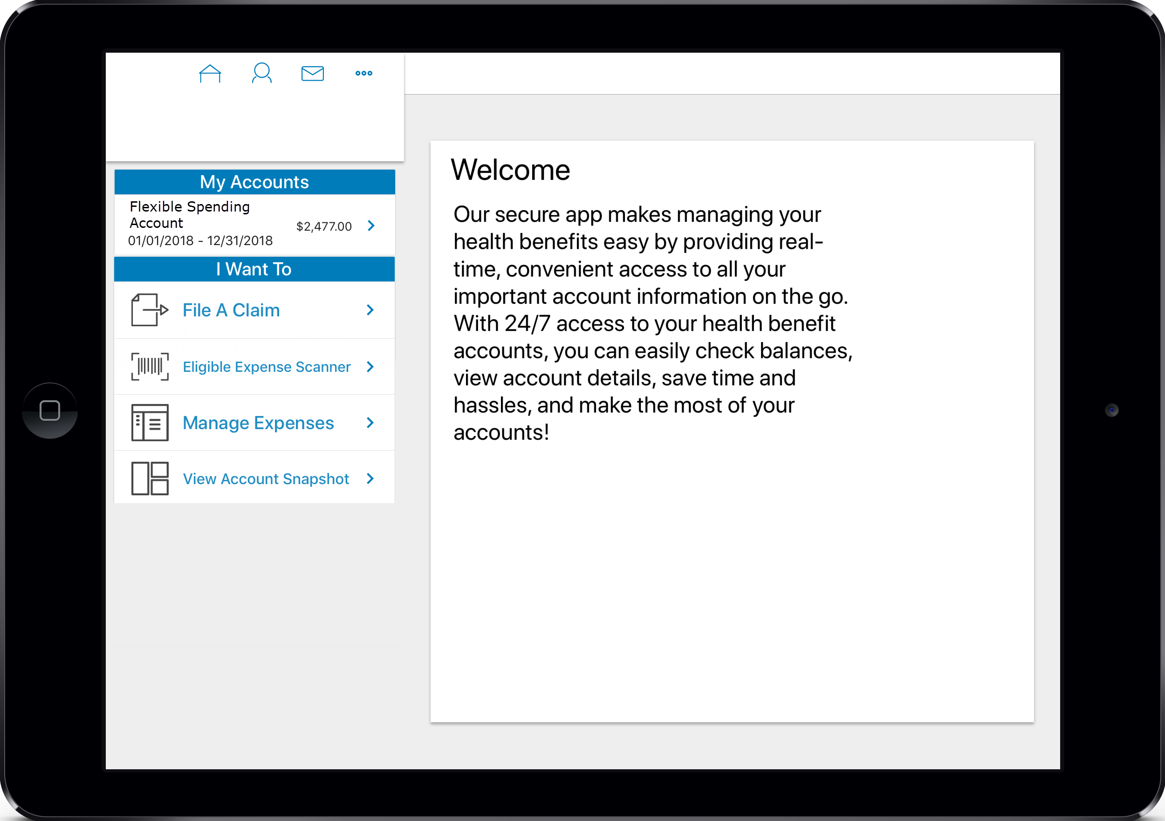
Online Claim Submission
Access your account online using your computer or our mobile app
Submit claims and upload receipts using your phone or computer
View your account and update your contact information as needed
Add your bank account to allow direct deposit of reimbursements
www.mybenefitsnm.com

Slide 12
Paper Claim Submission
Access paper forms on our website
Include all appropriate documentation, including receipts/EOBs and letters of medical necessity (if required)
Documents must show:
Your Name or Dependent Name
Service Provider
Date Incurred
Amount Incurred
Type of Expense
Email: sonm@easitpa.com
Fax: (505) 244-6009
Phone: (505) 244-6000
Mail:
Flexible Spending Accounts
Erisa Administrative Services, Inc.
1200 San Pedro Dr. NE
Albuquerque, NM 87110

Slide 13
Transition from CompuSys to EASI
NEW
UPDATED
NO CHANGES
Debit Cards for Dependent Care
Mobile Application
Online Portal
Debit Card Design
Contact Information
Enrollment Process
Plan Rules
2019 FSA claims will continue to be handled by CompuSys through the runout period.
2020 FSA claims will be processed by Erisa Administrative Services, Inc.

