Slide 1





State of New Mexico and Local Public Bodies
Group Benefits Health Plan
January 2024 – December 2024
Presbyterian Health Plan
Nationwide HMO Plan

Slide 2

Presbyterian Nationwide HMO Plan
2024 Benefits Presentation
2024 Benefits One Plan Option, Two Provider Tiers: Tier I and Tier II
Free 24/7 Access to Convenient Quick Care Options
Provider Networks
New Mexico and National
Advocacy
Care Management
Gym Membership Program
Wellness Services

Slide 3
2024 Covered Benefits – Summary: Enhancements
One Plan Option with Two Provider Tiers Included
Benefit | Tier I Presbyterian Preferred Network | Tier II NM and Nationwide Network
Deductible: Individual / Two Party / Family (Combined Tier 1 and Tier II) | $350 / $700 / $1,050 | $500 / $1,000 / $1,500
Out-of-Pocket Maximum: Individual / Two Party / Family Combined with Express Scripts Member Liability (Combined Tier 1 and Tier II) | $3,750 / $7,500 / $11,250 | $4,250 / $8,500 / $12,750
Preventive Care* Telehealth Services – PCP, Specialist, UC* PresRN, Video Visits, Online Visits, Talkspace* Behavioral Health and Substance Abuse* Primary Care* PT/ST/OT* Specialty Care* Lab (Non Preventive)* X-Ray (Non Preventive)* Outpatient Surgery* | $0 $0 $0 $0 $25 $25 $45 $20 $100 $500 | $0 $0 $0 $0 $40 $40 $60 $20 $100 $500
Chiropractic (annual limit combined with acupuncture and combined Tier I and Tier II annual limit of 25 visits per calendar year)* Acupuncture (annual limit combined with chiropractic and combined Tier I and Tier II annual limit of 25 visits per calendar year)* Naprapathy (combined Tier I and Tier II annual limit of 25 visits per calendar year)* Massage (combined annual limit with Naprapathy and combined Tier I and Tier II annual limit of 25 visits per calendar year)* | $25 $50 $55 $55 ($0 Copay with BH Diagnosis Code) | $40 $50 $55 $55 ($0 Copay with BH Diagnosis Code)
MRI/PET/CT Scans* | $250 per test per day | $250 per test per day
Urgent Care- All Inclusive* Durable Medical Equipment Emergency Care Hospitalization Maternity Care* Maternity Hospitalization* *Services not subject to deductible | $100 20% coinsurance after deductible 20% coinsurance after deductible 20% coinsurance after deductible $25 (1st Visit Only) $1,000 | $100 20% coinsurance after deductible 20% coinsurance after deductible 20% coinsurance after deductible $40 (1st Visit Only) $1,000

Slide 4



Free 24/7 Access to Convenient Quick Care Options
For Everyday Ailments

Slide 5
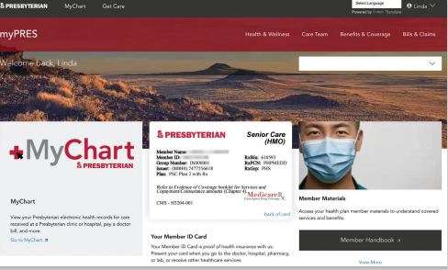
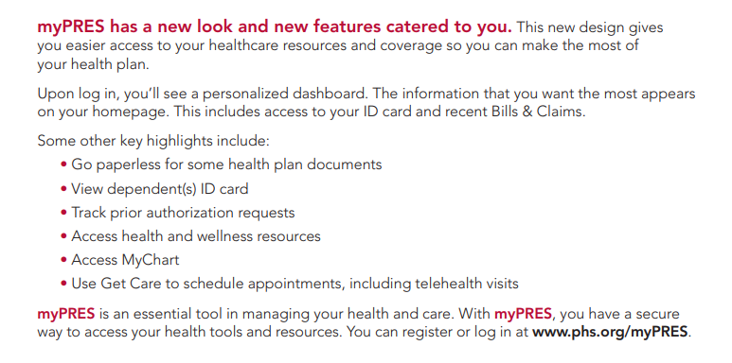
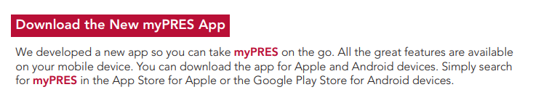
A New myPres Just For You

Slide 6
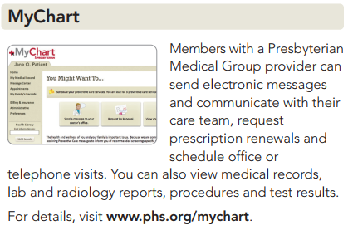
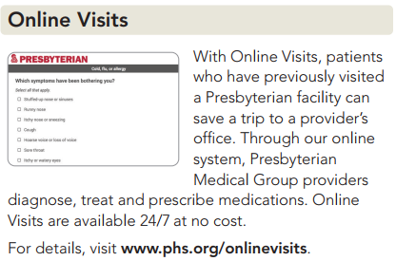
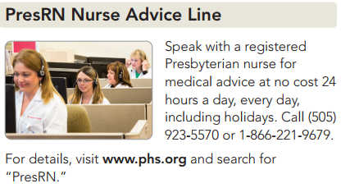
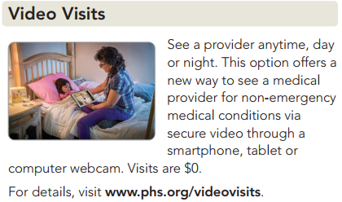
More Access to Care Without Paying More
Access 24/7 Services through your MyPres account or below resources:
phsgetcare.org or www.phs.org/sonm

Slide 7




No-Cost Care Offers Convenience
Video chat or text with a NM licensed and credentialed therapist, 24 hours a day. Engage with a therapist as much as needed at a time and place that is convenient for you.
Access self-help tools 24 hours a day to help cope with
common behavioral health matters.
Connect with case managers during severe occurrences.
Get the help that you need to quit smoking and stay quit. Engage through a mobile app to access numerous tools and resources for quitting nicotine.
Global emergency travel assistance services 24 hours a day. Connects you to services when experiencing a medical emergency while traveling more than 100 miles from your home or in another country.
Access 24/7 Services through your MyPres account or below resources:
www.phs.org/sonm

Slide 8

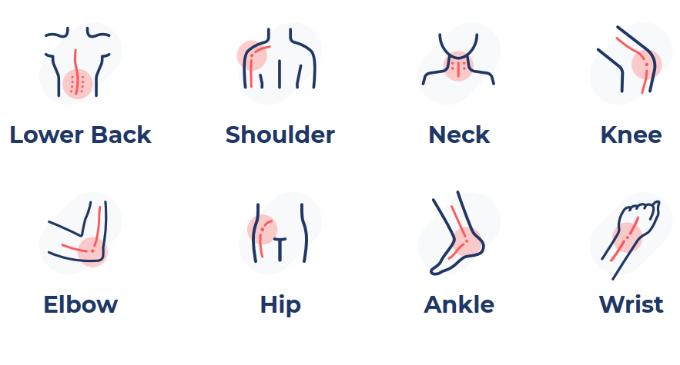
Sword Health – A Solution for Everyone
Sword Health provides a digital solution to MSK issues that is cost-effective and equitable to a wide range of members
Available 1/1/2024

Slide 9


Provider Network
Tier I and Tier II
Better Health Outcomes, Just In Case

Slide 10


Tier 1 Provider Network
Statewide Value Based Preferred Network
Subset of Presbyterian Provider Network (all other contracted providers including national providers through Multiplan remain in Tier II)
Focus on Improving Clinical Quality Outcomes and Lowering Costs
Lower Out-of-Pocket Cost for Specific Benefits
  Deductible (only applicable to Hospitalization, Emergency Room, Ambulance and Durable Medical Equipment)
  Out-of-Pocket Maximum
  Primary and Specialty Care Copays
All Other Copays Identical for Tier I and Tier II Providers
Telehealth (PCP, Specialist, UC) and Behavioral Health Services Covered at 100%: Tier I and Tier II
Tier I and Tier II Provider Networks: www.phs.org/sonm

Slide 11
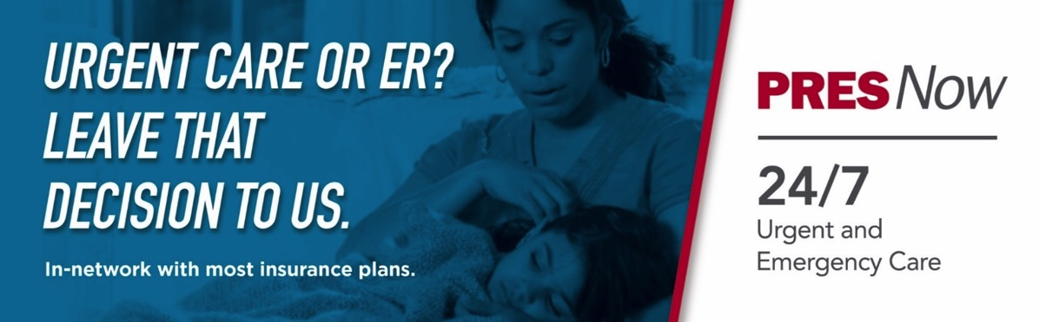
Tier I - Albuquerque’s Only 24/7 Urgent Care
Only Pay for What You Use
Three locations in Albuquerque
  San Pedro and Paseo de Norte
  Coors and Western Trail
  Isleta and Rio Bravo
Fourth location expected in 2024

Slide 12
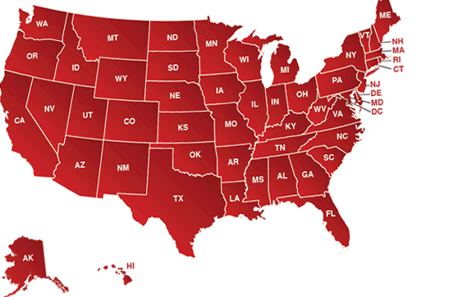
Access All Current Providers: Tier I and Tier II Combined
Extensive State and Nationwide Contracted Provider Network
New Mexico Provider Network Tier I and Tier II
Over 24,000 Primary Care and Specialty Providers
* No Referrals Required
Presbyterian Providers and Hospitals Statewide
Independent Providers and Hospitals Statewide
www.phs.org/sonm
Tier I and Tier II
Covered at 100%
Preventive Services
Telehealth (PCP, Specialist, UC)
Behavioral health
New National Network
PHP will replace current national provider network to a larger, more recognizable network in 2024
The new network will have access to more than 1.5 million health care professionals and specialists and 6,000 hospitals nationwide
Nearly all, ~98% providers contracted through the current MultiPlan/PHCS will be included in the new network
Member access to care within New Mexico and existing PHP in-network providers will remain the same and member ID numbers will not change
New logo on ID cards and how to access new national network will be available by 2024
www.phs.org/sonm

Slide 13
New National Network Partner - Aetna
Presbyterian Health Plan has partnered with Aetna Signature Administrators®, to offer access to Aetna’s national network and their partner networks. These networks now offer more than 1.5 million participating physicians and ancillary providers, including over 6,000 hospitals.
This change will take effect 12/1/2023
New ID cards will be issued prior to 1/1/2024 to all new/current members with the Aetna logo and claims submission information
  To access your ID card immediately, please login to MyPres or create a MyPres account at phs.org/myPRES
Provider network search tool can be found using the link below (only to be used for outside of NM providers):
  http://aetna.com/asa
Any members currently using a MultiPlan/PHCS provider please use the provider search tool to verify if your provider is contracted with Aetna
  Transition of Care is available on a case-by-case basis, forms can be found at phs.org

Slide 14

Advocacy
Care Management
Wellness Program
Fitness Pass Gym Program

Slide 15

Dedicated Member Service Team
(505) 923-5600, 1-888-ASK-PRES
Email: info@phs.org
SONM Custom Website: www.phs.org/sonm
Only Local and Integrated Customer Service Team in New Mexico
Strive for One Call Resolution
Benefit, Transition of Care, and Billing Questions
Provider Scheduling Assistance: Telehealth or In-person PCP or Specialist
Member Navigation / Site of Service Redirection to Lowest Cost Setting
Referrals to Clinical Programs – Disease / Care Management and Community Health Workers

Slide 16

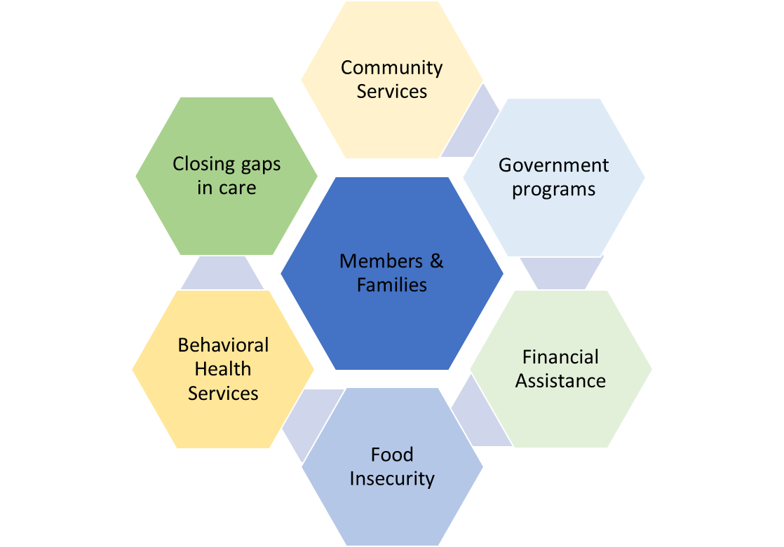
Improving Health Outcomes Collaboratively
Comprehensive Disease Management Program
1-800-841-9705 or healthysolutions@phs.org
Licensed nurses work with your healthcare provider to provide you with coaching and self-management tools to manage chronic conditions such as:
Diabetes
Asthma
Chronic Obstructive Pulmonary Disease (COPD)
Congestive Heart Failure (CHF)
Coronary Artery Disease (CAD)
Care Coordination
1-866-672-1242 or phpreferral@phs.org
Provides support for:
Managing cancer
Low back pain/musculoskeletal conditions
Manage complex acute medical needs such as transplants, high-risk pregnancies, and transition of care.
Community Health Workers
505-923-8567
Taking up where the healthcare providers leave off:
Community services
Government programs
Extension of medical services and cost assistance
Food insecurity
Behavioral Health Services
Notes:
Through Inpatient Telemed Services we are also expanding regional care
Access to Specialized inpatient care in the regional facilities
Eliminating the need to transfer patients to Albuquerque
Reducing complications due to transport and improving quality outcomes
Eliminating the financial waste associated with the transfers.

Slide 17

Good Measures Nutrition Coaching
Health Coaching
2023-2024
Wellness
Offerings
Wellness at Work®
Stay Informed
Wellness Webinars
Wellness Programs
Connect with a Registered Dietitian. Track nutrients, sleep and blood pressure
Set goals and make life-style changes with
one-on-one coaching.
Informative interactive sessions on advancing your wellness journey
Earn $25 gift card for completing your Health Check and staying engaged
Emails, newsletters and other programming.
Check benefits website.
New in 2024!!

Slide 18



Keep Moving with a Fitness Pass Membership
The 2024 cost is only $22.50 per eligible member per month
Enrollment is Open Year-round
Access as many gyms simultaneously, there is no limit to the number of gyms you can utilize!
As a Presbyterian Health Plan member, you and your dependents have access to more than 10,000 fitness, recreation and community centers, including:
Defined Fitness locations in Albuquerque, Rio Rancho, Farmington and Santa Fe
Prime Fitness network (nationwide)
Discounted Membership Fees at all Sports & Wellness facilities
Defined Fitness is one of New Mexico’s premier health clubs, offering a wide variety of group exercise classes, supervised child care and state-of-the-art strength training and cardiovascular equipment. All locations feature an aquatic complex with an indoor pool, hot tub, dry sauna and steam room.
The Prime Fitness network provides group exercise classes and amenities such as pools, sport courts, tracks and more. You can visit participating locations nationwide as often as you like, including select CHUZE, YMCAs, Snap Fitness, Curves® and more. When you use Prime Fitness, your fitness travels with you.
Sports & Wellness is where Albuquerque has gone to find fun, friends and fitness for 25+ years. Enjoy a special Presbyterian discount off traditional membership fees and experience five-star service and first-rate amenities at five New Mexico locations and other clubs across the country.

Slide 19
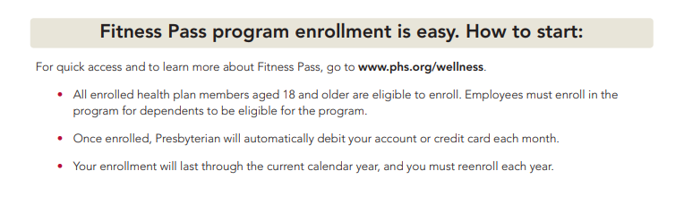
Fitness Pass Enrollment
The 2024 cost is only $22.50 per eligible member per month.
Enrollment is Open Year-round
Presbyterian Members Are Eligible To Enroll with January 1, 2024 Effective Date
(Enroll in December prior to 12/20 to Ensure Gyms Have Eligibility Prior to 1/1/24)
Enrollment is Effective 1st of the Month Following Online Enrollment
*Must Reenroll Annually in December to Continue the Program the Following Calendar Year
All enrolled health plan members aged 18 and older are eligible to enroll.
Subscriber (policy holder) must enroll for dependents to enroll.
Your enrollment will last through the current calendar year and can not be changed or cancelled voluntarily, and you must reenroll each year.
Once enrolled, Presbyterian will automatically debit your account or credit card each month.
  Debit will occur the last week of the month. If you enroll after the 17th of the month you will be debited for two months fees the following month but your gym membership will still be effective the 1st of the month following enrollment.

Slide 20

If you choose Presbyterian,
you can use Presbyterian.
Provider Network
New Mexico and Nationwide
One Plan to Enroll Into Includes Both Tiers: Tier I and Tier II
Better Health Outcomes, Just In Case
Advocacy, Care Management and Fitness Pass
Dedicated Member Service Team
Community Health Workers
Wellness Program
Fitness Pass Gym Membership
Free 24/7 Access to Convenient Quick Care Options
For Everyday Ailments

