Slide 1

State of New Mexico And Local Public Body Employees
Supplemental Life Insurance

Slide 2

Important Dates to be in The Know
Enroll with Globe Life
24/7/365
Website: sofnm.esdglobe.com
Effective Date
Based on receipt of 1st payroll deduction
Estimated Date of 1st Deduction
1st or 2nd payday following submission of
your application

Slide 3
Supplemental Life Insurance*
Introduction to ESD
Supplemental Life Insurance Coverage
Why purchase coverage?
Product Details
Enrollment
Closing Remarks
*Life coverage underwritten by Globe Life And Accident Insurance Company.

Slide 4

The Company Behind the Coverage
Since 1951, Globe Life And Accident Insurance Company has developed insurance policies from suggestions made by our policyholders. We know the need for insurance that is simple, affordable, and easy to understand.
Over $227B of coverage in force*
Over
4.2 Million policyholders & over 16 Million lives protected*
A (Excellent) Financial Strength Rating from A.M. Best Company (10/24)**
*All company statistics shown are based on current internal data. Excluding reinsurance companies.
**This rating refers only to the financial strength of the company and is not a recommendation of the specific policy provisions, rates or practices of the insurance company.

Slide 5


Globe Life – Employee Services Division
The Employee Services Division of Globe Life And Accident Insurance Company cares about its commitment to civil service employees. We strive to continually meet the needs of civil service employees with qualified supplemental life and health insurance products.
Notes:
Good afternoon and thank you committee members for allowing Globe Life to present today.
My Name is Omar Borrego…
We find ourselves today in unique times. It is encouraging and appreciated that we have the ability to move forward with this RFP process.
For over 40 years the Employee Services Division of Globe Life has been committed to servicing the government employee market. The goal of our presentation is to highlight the unique offerings Globe Life has for you.
The State of New Mexico is very fortunate to have individuals like yourselves looking out for their best interest. I saw this demonstrated by the descriptive nature of your questions to us. You’ve asked how we will be there for that “grieving” family that lost a loved one that was the sole income earner.
It is that level of compassion that needs to surround the topic of life insurance.
Fact of the matter is that all insurance providers need to address there claims in a legal and expeditious manner. They need to offer solid customer service and make it easy to do business with.
However, if the insurance is not purchased…then the client will never know how claims would have been paid and customer service handled. Therefore it comes down to the caliber of agent in discussion with the employee.
This is where I feel a large strength of Globe Life resides…In the hands of the enrollers that take the time to EDUCATE a client on their existing coverage. They have a PASSION for life insurance.
Here is a quote that I feel summarizes what Globe Life is all about. “”””””

Slide 6

One Division – Representing Two Companies
Employee Services Division of Globe Life And Accident Insurance Company
(ESD)
Globe Life And Accident Insurance Company
Life Insurance

Slide 7
Supplemental Life Insurance*
Introduction to ESD
Supplemental Life Insurance Coverage
Why purchase coverage?
Product Details
Closing Remarks
*Life coverage underwritten by Globe Life And Accident Insurance Company.

Slide 8

Why Purchase Supplemental Insurance?
Why do I need Life insurance?
Life insurance may be able to help your family prepare for the unexpected and help provide financial protection that can last a lifetime.
What is supplemental life insurance?
This optional coverage complements your existing employer provided life insurance coverage. It is made available to help employees meet their individual needs.
Why should I purchase coverage now?
Securing coverage at your age and health today helps prevent a time when life insurance may be prohibitive in the future.

Slide 9
Strength Of Product
Whole Life Paid up at Age 65*
Level Premium
Portable Coverage
Permanent Coverage
Fixed Benefit
Generates Cash Value
Guarantee Issue**
Additional Features:
Cost friendly coverage starting at $1.50 weekly premium, based on age
$2 weekly premium for $10,000 Children’s Term Insurance Rider, regardless of number of children covered
Waiver of Premium Disability Rider already included
Terminal Illness Accelerated Benefit Rider already included
Accidental Death Benefit Rider available: $16,000 for $.50 a week and $32,000 for $1 a week
*Product limitations and restrictions may apply. Product also available for Paid for Life premium.
**Not available to individuals who are HIV positive or terminally ill.

Slide 10
Eligible Participants
Eligible Participants That May Apply for Guarantee Issue Coverage
Regular working government employees
❑ Spouse of employee
❑ Children (30 days through age 23)
❑ Step-children (30 days through age 23)
❑ Adopted Children (30 days through age 23)
❑ Grandchildren (30 days through age 23)
❑ Parents of employee or spouse
❑ Other family members subject to underwriting

Slide 11
Deposit Fund Rider
Deposit Fund Rider | Deposits made regularly with premium payments to create an interest bearing account. Guaranteed minimum interest rate will be 3% for all years the rider is in force. Funds can be used for any purpose. No penalty or charge for withdrawals. Deposit Fund will be given to beneficiary of life insurance policy, in the event of death.
This is a solicitation for insurance. You may be contacted by an agent representing Globe Life And Accident Insurance Company. Policy and Rider Forms: ESWL2001; ESWL2001GD; 17ESDIADR; 17ESDICR; 17FP-416R; 17GABR1; GDFR3.
Notes:
This slide covers your question related to “savings opportunities” during the pendency of a plan.
This Whole Life Product is permanent and portable.
Our obligation to a policyholder begins at point of issuance of a policy.
Globe Life Whole Life Product is an individual product where conversion is not applicable.
Q2 = savings opportunity

Slide 12
*Available Riders
Terminal Illness Accelerated Benefit Rider | Upon proof of terminal illness, insured will receive 50% of the current benefit available prior to death.
Waiver of Premium Disability Rider | Upon proof of the insured’s total disability as defined by this rider, the company will waive any premiums due.
Accidental Death Benefit Rider | The rider pays up to $32,000 for an Accidental Death. This benefit pays in addition to other sums collected under the policy.
Children’s Term to 25 Rider | Upon proof of the insured child’s death, policy will pay beneficiary up to $10,000.
*Riders listed are subject to policy provisions. Availability to vary by product purchased.

Slide 13

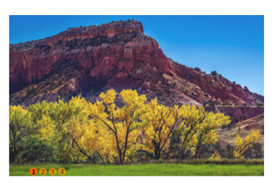
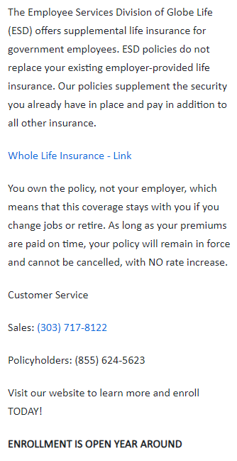
Enrollment
SONM VOLUNTARY BENEFIT PLAN OPTIONS
Our Website
https://sofnm.esdglobe.com

Slide 14

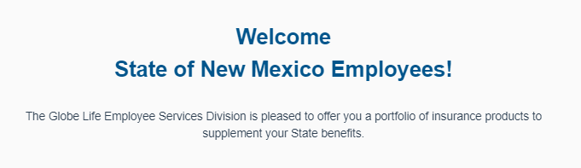
Enrollment

Slide 15
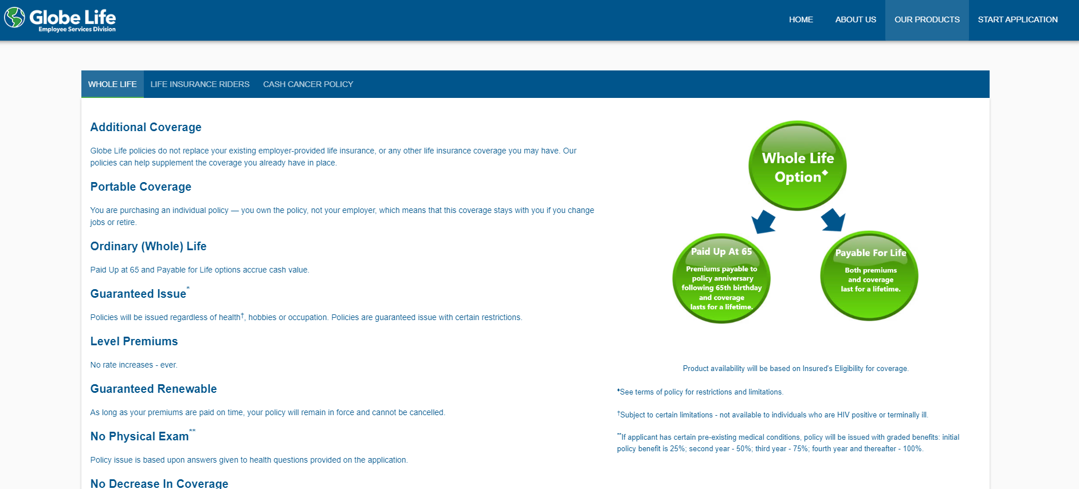
Enrollment

Slide 16
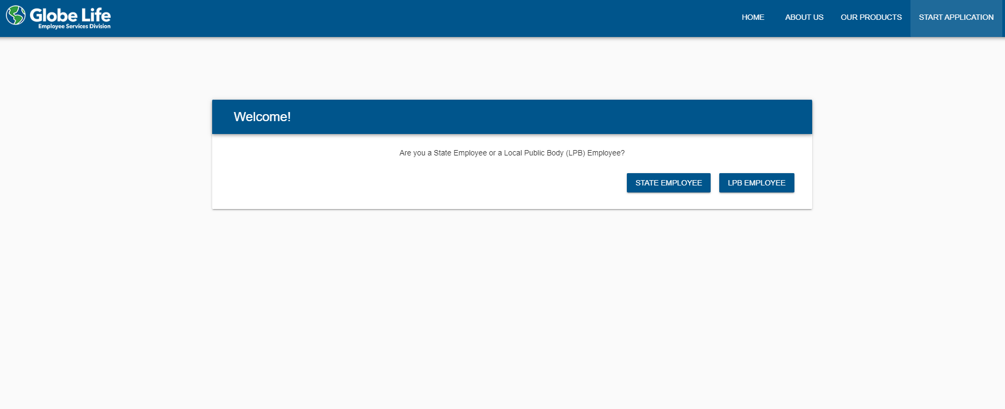
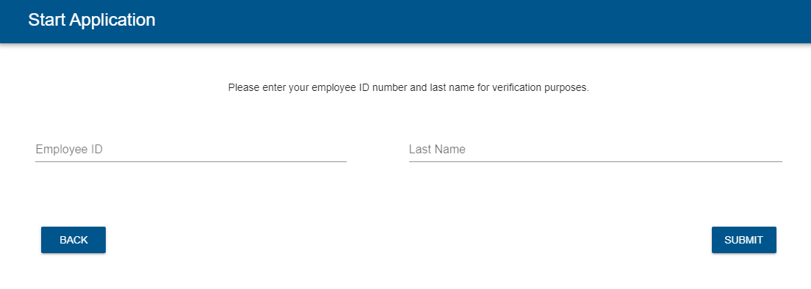
Enrollment

Slide 17
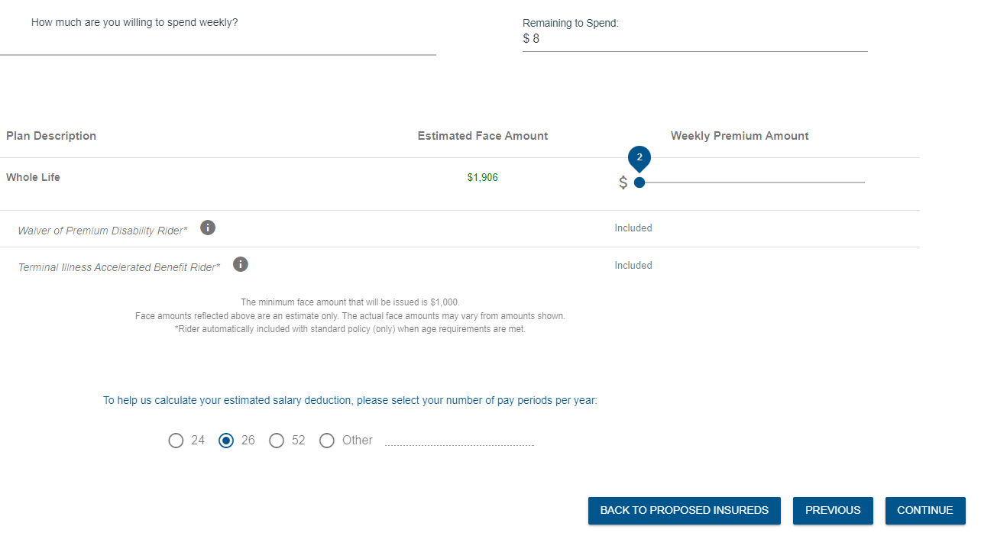
Enrollment

Slide 18
Important Dates to be in The Know
Enroll with Globe Life
24/7/365
Effective Date
Based on receipt of 1st payroll deduction
Estimated Date of 1st Deduction
1st or 2nd payday following submission of
your application

Slide 19

Closing Remarks
Globe Life offers you the opportunity to plan today for the financial security of your family…
Don’t put off the important decision to help provide for your family’s protection and welfare.

Slide 20

Closing Remarks
Thomas Gomez
Managing General Agent
(303) 717-8122
tklgomez@msn.com
Drive for show.
Putt for dough.
Globe Life Enrollment Website
https://sofnm.esdglobe.com

Slide 21
Thank you for this opportunity.

