Slide 1
COVERAGE THAT COUNTS: AFFORDABLE PROTECTION
Health Care Authority
438220 NS 10/20 © 2020 The Hartford. Confidential. No part of this document may be reproduced, published or posted without the permission of The Hartford.

Slide 2
HELPING YOU PREPARE FOR THE UNEXPECTED: YOUR BENEFIT OPTIONS
Supplemental Life and AD&D Insurance
Who is eligible?
All Active Full Time & Part-Time employees who work at least 20 hours per week on a regularly scheduled basis.
When can you enroll?
Within 31 days of your new hire eligibility or during your annual enrollment
| COVERAGE THAT COUNTS: AFFORDABLE PROTECTION
Health Care Authority (on24.com)
438220 NS 10/20 © 2020 The Hartford. Confidential. No part of this document may be reproduced, published or posted without the permission of The Hartford.

Slide 3
Life and Accidental Death & Dismemberment (AD&D)
6080h NS 08/20 Copyright © 2020 The Hartford. Confidential. No part of this document may be reproduced, published or posted without the permission of The Hartford.

Slide 4
Supplemental Life and AD&D Insurance
Benefit amount - $10,000 – $500,000
In $10,000 increments
Spouse Benefit: $10,000 - $250,000
In $10,000 increments
Child Benefit (live birth to age 26): $5,000, $10,000 or $15,000
Portability
Supplemental AD&D benefit will match your supplemental life benefit
Basic Life Insurance is provided by your employer. Please see your employer for benefit amount as they vary by class.
Customized to fit your needs
6080h NS 08/20 Copyright © 2020 The Hartford. Confidential. No part of this document may be reproduced, published or posted without the permission of The Hartford.

Slide 5
Naming a Beneficiary
A properly completed beneficiary designation ensures The Hartford will be able to understand whom you intended to receive the life benefits payable at your time of death.
You, as the employee, are automatically the beneficiary for any dependent life coverage.
If you do not designate a beneficiary, the policy provisions determine how benefits will be paid.
A divorce, annulment or similar event may not invalidate a beneficiary designation that names your former spouse. To remove your former spouse, you must submit a new designation.
A primary beneficiary is the beneficiary or beneficiaries that you name to receive the benefits if they are living at the time of your death.
Contingent beneficiaries are those named to receive the life insurance benefit if no primary beneficiary is alive at the time you die.
A minor can be named as a beneficiary, but benefits are not released directly to the minor child. The Hartford will pay benefits to the court-appointed guardian of the estate of the minor child.

Slide 6
VALUE ADDED SERVICES

Slide 7
The Hartford Life Essentials & Value-Added Services¹
Services for all stages of life
Travel Assistance Services Will Preparation Services Funeral Planning Services
Travel Assistance Services Will Preparation Services Funeral Planning Services
Travel Assistance Services Access to Empathy suite of bereavement services Grief Guidance Funeral Planning Obituary Writing Estate Planning ID Theft Dedicated Care Manager Access to digital app
Life
End of Life
Beneficiary
¹ Services are offered through vendors which are not affiliated with The Hartford and these services are not insurance. The Hartford is not responsible and assumes no liability for the goods and services described in this material and reserves the right to discontinue any of these services at any time. Services may vary and may not be available in all states. Visit https://www.thehartford.com/employee-benefits/value-added-services for more information.
6082k 12/23 © 2023 The Hartford. Confidential. No part of this document may be reproduced, published or posted without the permission of The Hartford.
Notes:
The Hartford provides services beyond the benefit for all stages of life – during an employees life, at the end of life and services for the bereaved to help guide them through their loss.

Slide 8
Empathy Bereavement Services¹ that go beyond the benefit
Grief Guidance
Help for all the difficult emotions they may be feeling
Funeral Planning
Checklists and templates to stay on top of every detail
Obituary Writer
A professionally written obituary in minutes
Care Manager
1:1 chat with a dedicated expert for guidance
Family Collaboration
Support for the process by sharing with up to 10 others on an account
Secure Vault
A safe place to upload, organize, and share crucial documents
Estate Administration
Guidance to the ins and outs of this complex process
Account Deactivation
Automated canceling of memberships, accounts and subscriptions
Estate Planning
Every detail worked out to save the family time and headaches
Knowledge Base
In-depth information on any topic
¹ Bereavement Services, Funeral Planning Services and Will Prep Services are provided through The Hartford by Empathy. Empathy is not affiliated with The Hartford and is not a provider of insurance services. The Hartford is not responsible and assumes no liability for the goods and services described in this material and reserves the right to discontinue any of these services at any time. Services may vary and may not be available in all states. Visit www.TheHartford.com/employee-benefits/value-added-services for more information.
6082k NS 12/23 © 2023 The Hartford. Confidential. No part of this document may be reproduced, published or posted without the permission of The Hartford.
8
Notes:
The Hartford will provide beneficiaries with full and free access to Empathy's services. Empathy is an organization that provides a support platform that holistically treats the whole person as they deal with the challenges of loss via dedicated Care Managers and a Digital App. Empathy is partnering with Hartford to ensure Beneficiaries and their families are fully supported during this difficult time.
Empathy is the comprehensive support system for loss, offering bereaved families holistic guidance and care for all of the administrative, emotional, legal, and financial challenges they face after their loved one passes away. Empathy’s comprehensive support system can be accessed via mobile phone app or online through a browser window. Families can also reach our Care Team via phone, on a dedicated The Hartford number. We offer multiple access paths to ensure we are supporting users in whatever way they are most comfortable.
When registering to create an account online or on a mobile device, users answer a few introductory questions, which allows Empathy to create a personalized experience, focusing on the areas where most support and guidance are needed. With a combination of technology and human support, beneficiaries can navigate all the aspects of loss: planning a funeral, writing an obituary, closing down a loved one’s accounts, settling their financial affairs, and more. On average, Empathy helps save $3,000 per funeral. At the same time, it has been made easy for them to collaborate with other family members, while making sure all of their loved one’s documents and personal information are private, safe, and secure. With a dedicated Care Manager supporting them every step of the way, they are fully supported as they tackle each task, decision, and challenge. Plus, they’ll have all of the information and advice to know that they are proceeding correctly. Topics covered in the Digital app include dealing with grief, searching for important documents, finding and filing a will, preventing identity theft, dealing with creditors, going through the probate process, paying taxes, and more.

Slide 9
Bereavement Services
Provided by Empathy¹
Grief Guidance
Licensed social workers provide emotional guidance
Guided meditation helps loved ones find encouragement
Self-care tools and reflection workflows
Funeral Planning Services
Obituary Writing
Estate Planning
Account Deactivation
Dedicated Care Manager
¹ Bereavement Services, Funeral Planning Services and Will Prep Services are provided through The Hartford by Empathy. Empathy is not affiliated with The Hartford and is not a provider of insurance services. The Hartford is not responsible and assumes no liability for the goods and services described in this material and reserves the right to discontinue any of these services at any time. Services may vary and may not be available in all states. Visit www.TheHartford.com/employee-benefits/value-added-services for more information.
6082k NS 12/23 © 2023 The Hartford. Confidential. No part of this document may be reproduced, published or posted without the permission of The Hartford.

Slide 10
Bereavement Services
Provided by Empathy¹
Grief Guidance
Detailed instructions and on-demand assistance with finding a funeral home
Help with identifying vendors, planning events and arranging all details
Funeral home cost negotiation assistance
Funeral Planning Services
Obituary Writing
Estate Planning
Account Deactivation
Dedicated Care Manager
¹ Bereavement Services, Funeral Planning Services and Will Prep Services are provided through The Hartford by Empathy. Empathy is not affiliated with The Hartford and is not a provider of insurance services. The Hartford is not responsible and assumes no liability for the goods and services described in this material and reserves the right to discontinue any of these services at any time. Services may vary and may not be available in all states. Visit www.TheHartford.com/employee-benefits/value-added-services for more information.
6082k NS 12/23 © 2023 The Hartford. Confidential. No part of this document may be reproduced, published or posted without the permission of The Hartford.

Slide 11
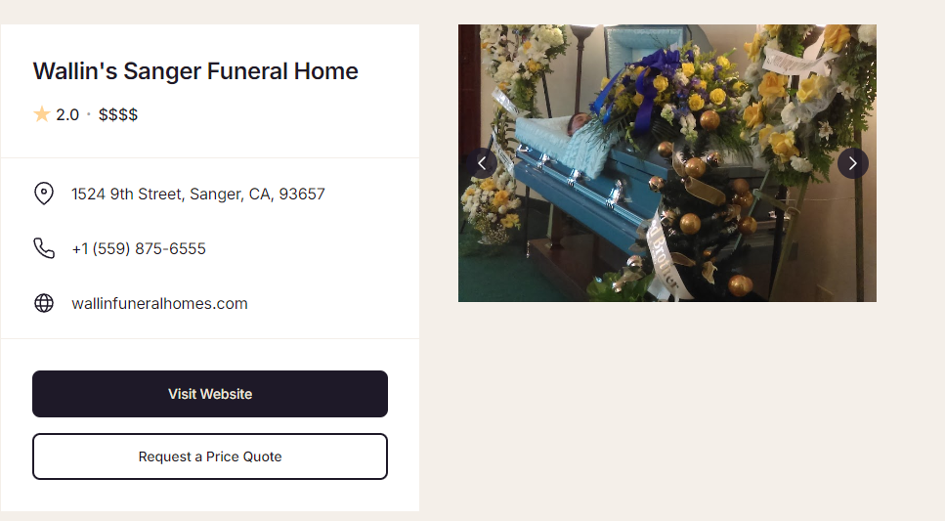
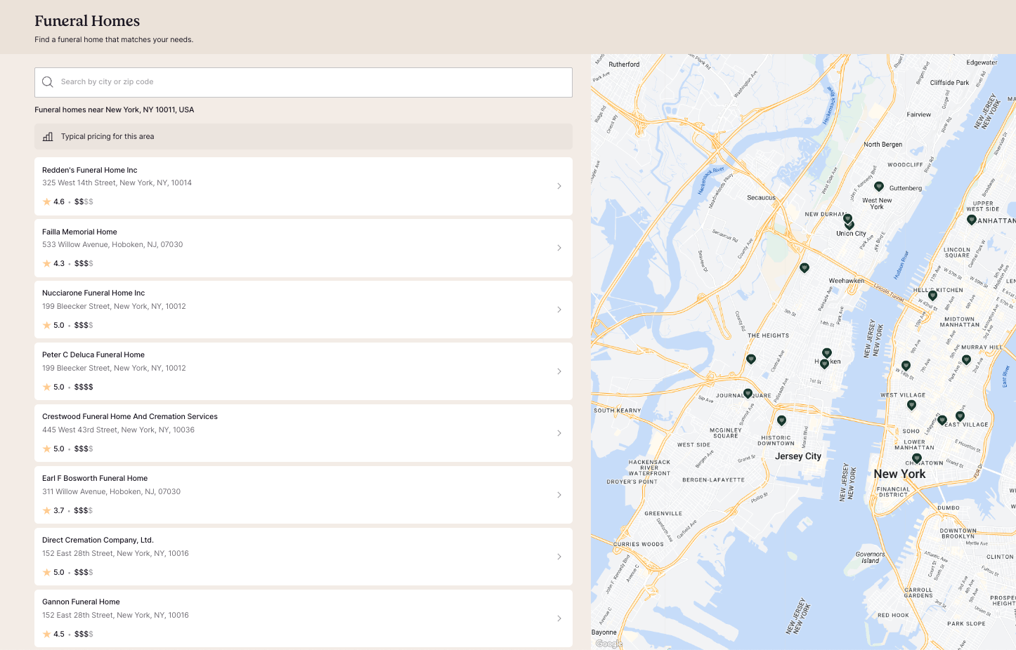
Empathy Funeral Home Finder Tool¹
¹ Bereavement Services, Funeral Planning Services and Will Prep Services are provided through The Hartford by Empathy. Empathy is not affiliated with The Hartford and is not a provider of insurance services. The Hartford is not responsible and assumes no liability for the goods and services described in this material and reserves the right to discontinue any of these services at any time. Services may vary and may not be available in all states. Visit www.TheHartford.com/employee-benefits/value-added-services for more information.
6082k NS 08/24 © 2024 The Hartford. Confidential. No part of this document may be reproduced, published or posted without the permission of The Hartford.

Slide 12
Bereavement Services
Provided by Empathy¹
Grief Guidance
Online obituary writing wizard tool offers step-by-step guide
Details collected and crafted into beautiful tribute
Ready for publication in minutes
Funeral Planning Services
Obituary Writing
Estate Planning
Account Deactivation
Dedicated Care Manager
¹ Bereavement Services, Funeral Planning Services and Will Prep Services are provided through The Hartford by Empathy. Empathy is not affiliated with The Hartford and is not a provider of insurance services. The Hartford is not responsible and assumes no liability for the goods and services described in this material and reserves the right to discontinue any of these services at any time. Services may vary and may not be available in all states. Visit www.TheHartford.com/employee-benefits/value-added-services for more information.
6082k NS 12/23 © 2023 The Hartford. Confidential. No part of this document may be reproduced, published or posted without the permission of The Hartford.

Slide 13
Bereavement Services
Provided by Empathy¹
Grief Guidance
Estate administration experts available for on-demand support
Assistance with drafting a will and creating a last wishes document
Probate guidance and resources
Personalized guidance with state-specific instructions
Funeral Planning Services
Obituary Writing
Estate Planning/Administration
Account Deactivation
Dedicated Care Manager
¹ Bereavement Services, Funeral Planning Services and Will Prep Services are provided through The Hartford by Empathy. Empathy is not affiliated with The Hartford and is not a provider of insurance services. The Hartford is not responsible and assumes no liability for the goods and services described in this material and reserves the right to discontinue any of these services at any time. Services may vary and may not be available in all states. Visit www.TheHartford.com/employee-benefits/value-added-services for more information.
6082k NS 12/23 © 2023 The Hartford. Confidential. No part of this document may be reproduced, published or posted without the permission of The Hartford.

Slide 14
Bereavement Services
Provided by Empathy¹
Assistance with closing personal accounts on family’s behalf
Includes financial, memberships, subscriptions and social media accounts
Empathy will manage all necessary communications and avoid unnecessary charges
Grief Guidance
Funeral Planning Services
Obituary Writing
Estate Planning/Administration
Account Deactivation
Dedicated Care Manager
¹ Bereavement Services, Funeral Planning Services and Will Prep Services are provided through The Hartford by Empathy. Empathy is not affiliated with The Hartford and is not a provider of insurance services. The Hartford is not responsible and assumes no liability for the goods and services described in this material and reserves the right to discontinue any of these services at any time. Services may vary and may not be available in all states. Visit www.TheHartford.com/employee-benefits/value-added-services for more information.
6082k NS 12/23 © 2023 The Hartford. Confidential. No part of this document may be reproduced, published or posted without the permission of The Hartford.

Slide 15
Bereavement Services
Provided by Empathy¹
Care Manager interacts with family in way that works best for them (phone, email, text and digital app)
Dedicated Care Manager to assist through a multi-step process, adapted to each family’s unique needs
Personalized Care Plan created
Care Manager provides outlet for emotional challenges throughout the process
Grief Guidance
Funeral Planning Services
Obituary Writing
Estate Planning/Administration
Account Deactivation
Dedicated Care Manager
¹ Bereavement Services, Funeral Planning Services and Will Prep Services are provided through The Hartford by Empathy. Empathy is not affiliated with The Hartford and is not a provider of insurance services. The Hartford is not responsible and assumes no liability for the goods and services described in this material and reserves the right to discontinue any of these services at any time. Services may vary and may not be available in all states. Visit www.TheHartford.com/employee-benefits/value-added-services for more information.
6082k NS 12/23 © 2023 The Hartford. Confidential. No part of this document may be reproduced, published or posted without the permission of The Hartford.

Slide 16
Identity Theft Support Services¹
Education on prevention and steps to take following theft
Credit bureau notification
Credit information review
Identity theft affidavit assistance
Card replacement
Translation and emergency cash advance
¹ Services are offered through vendors which are not affiliated with The Hartford and these services are not insurance. The Hartford is not responsible and assumes no liability for the goods and services described in this material and reserves the right to discontinue any of these services at any time. Services may vary and may not be available in all states. Visit www.TheHartford.com/employeebenefits/value-added-services for more information.
6082k NS 12/23 © 2023 The Hartford. Confidential. No part of this document may be reproduced, published or posted without the permission of The Hartford.

Slide 17
Making Travel Safer
Travel Assistance
Overview
Emergency Transport Services
Medical Assistance
Other Travel Services
6082k NS 12/23 © 2023 The Hartford. Confidential. No part of this document may be reproduced, published or posted without the permission of The Hartford.
17

Slide 18
Making Travel Safer
Travel Assistance¹
For business or pleasure
Over 100 miles from home for 90 days or less
For employee, spouse and dependent children under age 26
Overview
Emergency Transport Services
Medical Assistance
Other Travel Services
¹ Services are offered through vendors which are not affiliated with The Hartford and these services are not insurance. The Hartford is not responsible and assumes no liability for the goods and services described in this material and reserves the right to discontinue any of these services at any time. Services may vary and may not be available in all states. Visit www.TheHartford.com/employeebenefits/value-added-services for more information.
6082k NS 12/23 © 2023 The Hartford. Confidential. No part of this document may be reproduced, published or posted without the permission of The Hartford.

Slide 19
Making Travel Safer
Travel Assistance¹
Such as medical evacuations, repatriations of remains and more.
Overview
Emergency Transport Services
Medical Assistance
Other Travel Services
¹ Services are offered through vendors which are not affiliated with The Hartford and these services are not insurance. The Hartford is not responsible and assumes no liability for the goods and services described in this material and reserves the right to discontinue any of these services at any time. Services may vary and may not be available in all states. Visit www.TheHartford.com/employeebenefits/value-added-services for more information.
6082k NS 12/23 © 2023 The Hartford. Confidential. No part of this document may be reproduced, published or posted without the permission of The Hartford.

Slide 20
Making Travel Safer
Travel Assistance¹
World-wide medical referrals
Medical monitoring
Assistance with prescriptions
Replacing medical devices
Overview
Emergency Transport Services
Medical Assistance
Other Travel Services
¹ Services are offered through vendors which are not affiliated with The Hartford and these services are not insurance. The Hartford is not responsible and assumes no liability for the goods and services described in this material and reserves the right to discontinue any of these services at any time. Services may vary and may not be available in all states. Visit www.TheHartford.com/employeebenefits/value-added-services for more information.
6082k NS 12/23 © 2023 The Hartford. Confidential. No part of this document may be reproduced, published or posted without the permission of The Hartford.

Slide 21
Making Travel Safer
Travel Assistance¹
Pre-trip information
Lost luggage/document assistance
Legal referrals
Overview
Emergency Transport Services
Medical Assistance
Other Travel Services
¹ Services are offered through vendors which are not affiliated with The Hartford and these services are not insurance. The Hartford is not responsible and assumes no liability for the goods and services described in this material and reserves the right to discontinue any of these services at any time. Services may vary and may not be available in all states. Visit www.TheHartford.com/employeebenefits/value-added-services for more information.
6082k NS 12/23 © 2023 The Hartford. Confidential. No part of this document may be reproduced, published or posted without the permission of The Hartford.

Slide 22
WRAP-UP AND Q&A
Available plans
Supplemental Life & AD&D Insurance
Learn more at:
Health Care Authority (on24.com)
| COVERAGE THAT COUNTS: AFFORDABLE PROTECTION
438220 NS 10/20 © 2020 The Hartford. Confidential. No part of this document may be reproduced, published or posted without the permission of The Hartford.

Slide 23
THANK YOU!
| COVERAGE THAT COUNTS: AFFORDABLE PROTECTION
The Hartford® is The Hartford Financial Services Group, Inc. and its subsidiaries, including underwriting company Hartford Life and Accident Insurance Company. Home Office is Hartford, CT. All benefits are subject to the terms and conditions of the policy. Policies underwritten by the underwriting company listed above detail exclusions, limitations, reduction of benefits and terms under which the policies may be continued in force or discontinued. © 2020 The Hartford.
[Accident Form Series includes GBD-2000, GBD-2300, or state equivalent. Critical Illness Form Series includes GBD-2600, GBD-2700, or state equivalent. Disability Form Series includes GBD-1000, GBD-1200, or state equivalent. Hospital Indemnity Form Series includes GBD-2800, GBD-2900, or state equivalent. Life Form Series includes GBD-1000, GBD-1100, or state equivalent.]
438220 NS 10/20 © 2020 The Hartford. Confidential. No part of this document may be reproduced, published or posted without the permission of The Hartford.

