Slide 1



Welcome to the State of New Mexico's Open Enrollment
Group Benefits Health Plan
January – December Plan Year 2025
Blue Cross and Blue Shield of New Mexico, a Division of Health Care Service Corporation, a Mutual Legal Reserve Company, an Independent Licensee of the Blue Cross and Blue Shield Association
476174.0824
Notes:
Approved 07/30/24
EMI Team – Deborah Wells, Debb Bastian
Content pending approval by Debb Bastian
2024 PPO Open Enrollment Member Presentation should be customized for each use. Delete slides that do not apply and customize table data, dates, phone numbers, etc. as needed.
The file is divided into the following sections:
Introduction and PPO basics
Blue Distinction Centers
CDHPs
BlueEdge HSA
BlueEdge HCA
Digital Capabilities
Blue Access for Members
Provider Finder
Health and Wellness Programs
Well onTarget
Wellbeing Management-only slides
Health Advocacy Solutions-only slides
Member Rewards
Benefits Value Advisor
Virtual Visits
Dental
Prescription Drugs
Closing slides

Slide 2
Why Blue Cross and Blue Shield of New Mexico?
DEBB
More Doctors
and Hospitals
Coverage
Everywhere You Go
Personalized
Customer Service
Health and
Wellness Programs
Tools and Resources
Digital
Capabilities

Slide 3

Plan Options
LAUREN

Slide 4
Benefits Comparison
JEFF K
Benefit | HMO | Blue Preferred Plus PPO
 | IN-NETWORK | Tier 1 IN-NETWORK Blue Preferred Plus (NBP) | Tier 2 IN-NETWORK Preferred (PPO) | Tier 3 OUT-OF-NETWORK Nonpreferred Provider (OON)
Individual/Two-Person/Family Deductible | $425 / $850 / $1,275 | $500 / $1,000 / $1,500 | $700 / $1,400 / $2,100 | $3,000 / $6,000 / $9,000
Individual/Two-Person/Family Out-of-Pocket Max** | $4,000 / $8,000 / $12,000 | $4,000 / $8,000 / $12,000 | $5,600 / $11,200 / $16,800 | $9,000 / $18,000 / $27,000
Primary Care/Specialist Visit | $35 / $50 | $40 / $60 | $50 / $70 | 50%*
Mental Health Services | $0 | $0 | $0 | 50%*
Preventive Care/Telehealth Services | $0 | $0 | $0 | Preventive Care: 50% (deductible waived) Telehealth: 50% after deductible
Inpatient Admission | $700* | $1,250* | $1,750* | 50%*
Emergency Room | $300* | $325* | $325* | $325* (after in-network deductible)
Urgent Care | $60* | $65* | $75* | $75* (after in-network deductible)
Lab, X-Ray, EKGs and Other Diagnostic Tests | 25%* | 30%* | 40%* | 50%*
PET Scans, CT Scans and MRIs | 25%* (up to a max. member share of $250 per test) | 25%* (up to a max. member share of $300 per test) | 35%* (up to a max. member share of $300 per test) | 50%*
*After deductible **Medical and Rx combined

Slide 5
HMO – How It Works
  Out-of-Network Providers
  In-Network Providers
No coverage except for emergency room and urgent care services
  Access to contracted HMO, in-network providers in New Mexico
  No need to obtain referrals for specialist care
  Provider files claims
  Predictable copayments
  Away from Home Care® Program available in certain states

Slide 6
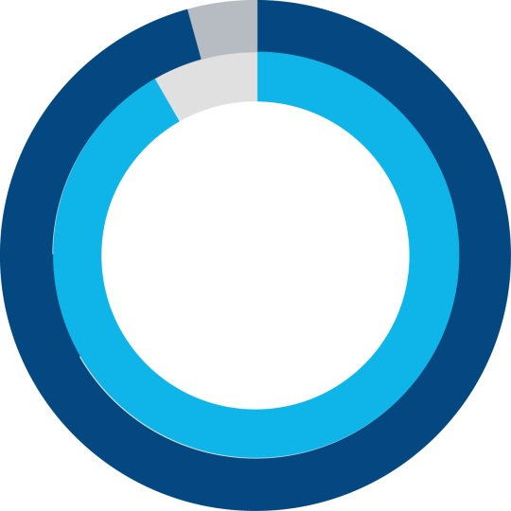







HMO Plan
JEFF K
Over 45,400 HMO-contracted providers in New Mexico including:
BCBS
When traveling outside of New Mexico, you have access to emergency room and urgent care services.
When you or your covered dependents are away from home for more than 90 consecutive days, you will be able to enroll as a Guest Member of an HMO-participating state. Please call to verify participating states.

Slide 7

Away From Home Care Program – HMO
Before enrolling in the BCBSNM HMO Plan
Contact BCBSNM Customer Service and confirm if that particular state participates in the Away From Home Care program.
Please note that not all states participate in this program.
After enrolling
Once you have enrolled in the HMO Plan, a Customer Service Advocate will work with you to complete a Guest Membership application, which is required for the Host HMO to provide you with a membership ID card.

Slide 8
Blue Preferred Plus PPO – How It Works
  Out-of-Network Providers
DRAWBACKS
  You do have coverage, but
You pay a greater share
of the costs
You may receive fewer benefits out-of-network
You may need to file your own claims
You may be billed for charges over the allowed amount (balance billing)
  In-Network Providers
ADVANTAGES
Receive the highest level of benefits and potentially pay less for care
Protection from billing over the allowed amounts (balance billing)
No claim forms (provider files claim)
No referrals required
No requirement to select a PCP
Access to a national PPO network

Slide 9
Blue Preferred Plus – 3-Tiered Provider Options
JEFF K
Tier 1 – Blue Preferred PlusSM Providers:
  You receive the highest level of benefits when you see a provider in the Blue Cross and Blue Shield of New Mexico (BCBSNM) Blue Preferred Plus Network (Blue Preferred providers are only in the state of New Mexico).
Tier 2 – Preferred PPO Providers:
  You receive a higher level of benefits when you see a contracted PPO provider with Blue Cross and Blue Shield anywhere in the U.S.
    No balance billing and Provider files claim for you
Tier 3 – Nonpreferred Out-of-Network (OON) Providers:
  You receive a lower level of benefits when you see an out-of-network provider.
    You will be responsible for paying the provider
    You could be balance billed
    You are responsible for getting prior authorization, when required

Slide 10
Blue Cross and Blue Shield of New Mexico Blue Preferred Plus Network
JEFF K
The Blue Preferred network (Tier 1) includes a variety of doctors, hospitals and other health care providers throughout New Mexico that can meet your health care needs.
With the Blue Preferred Plus plan, you will get the highest level of benefits when you visit the providers in the Blue Preferred network. You will still have the option of choosing a provider from the larger, statewide PPO network (Tier 2), but you will pay higher out-of-pocket costs than with the Blue Preferred network.
Over 45,000 (Tier 2) contracted providers in New Mexico including:

Slide 11
Differences Between HMO and PPO
HMO | PPO
Care is PCP-driven — you must select a medical group and PCP Referrals required for specialists Fixed predictable copays on covered services Smaller, more limited provider network National coverage is more limited You must stay in the HMO network: no out-of-network coverage, except in emergencies 90-day prescriptions at pharmacy | No referrals required: care is always your choice – each time Full PPO network with coverage across the U.S. and around the world Most services subject to deductible and coinsurance (you pay a percentage) Coverage both in- and out-of-network – at different levels Highest employee contributions

Slide 12

The strength of BlueSM
SHARON
ROBERTS
NUMBER 1
brand in health care
OVER 118 MILLION
members
MORE THAN
2 MILLION
unique, in-network providers
98%
of claims paid at in-network rates
Notes:
Approved 06/11/24
EMI Team – Deborah Wells, Debb Bastian
Content approved by Sharon Roberts
Blue Facts Sheet, BCBSA/BlueWeb (updated 5/24) https://www.bcbs.com/sites/default/files/file-attachments/page/Blue_Facts_Sheet-2024.pdf BCBS Fact Sheet
Blue Value Story Talking Points, BCBSA/BlueWeb (updated 11/23)
Blue Cross and Blue Shield members who live in another state can access the largest PPO network in the country through the BlueCard program.
The BlueCard program also allows members who need care when traveling to access their benefits. (Out-of-area coverage may vary by plan type.)
We make accessing doctors and hospitals a top priority, so our members have access to the best care possible – anytime – anywhere.
Based on the actual claims experiences of our group clients, in-network discounts and total cost of care are still foundational BCBS strengths. Due to the market-leading breadth of our
BlueCard network, more claims are in-network (98%) compared to our competitors (96%) leading to an overall lower cost of care.

Slide 13

Prior Authorization
LISA
Prior authorization is a process used to determine whether a medical service meets the requirements
for health plan coverage.
You need to have prior authorization for
some types of medical care such as:
  Hospital stays
  High-cost specialty drugs
  Some services you get outside a hospital
Your network provider will usually take care of prior authorization. To be sure, call Customer Service before your service.
Check your benefits booklet to learn more. You can find it on Blue Access for Members^{sm}

Slide 14

Online Tools

Slide 15
Blue Access for MembersSM
SERINA
CHRIS
  Through BAMSM, you can:
Once registered, view, print or download your member ID card
View claims status and history
See health care benefit information
Find a doctor or pharmacy near you
Update your communication preferences to go paperless
Log in and perform protected transactions
24 hours a day, 7 days a week*
Save time
with self-service support tools
and health and wellness resources available through
a convenient and secure website
*Claim Statements/EOBs are not available 3 – 6 a.m.
Notes:
Approved 06/18/24
EMI Team – Deborah Wells, Debb Bastian
Content approved by Serina Solomon and Eamon Madigan
Blue Access for Members
You can save time using self-service support tools, including the following and more:
Check the status of a claim; view and print Explanation of Benefits (EOBs)
View, print or download member ID cards
Confirm who is covered under the plan
Check plan coverage details and Rx benefit information
Secure access – employers can log in to their accounts and perform protected transactions 24 Hours a day, 7 days a week* [*Claim Statements/EOBs are not available 3-6 a.m.]
NOTE:
Blue Access for Members is available to all members. Options available within the portal will vary depending on group membership and benefit selections.

Slide 16
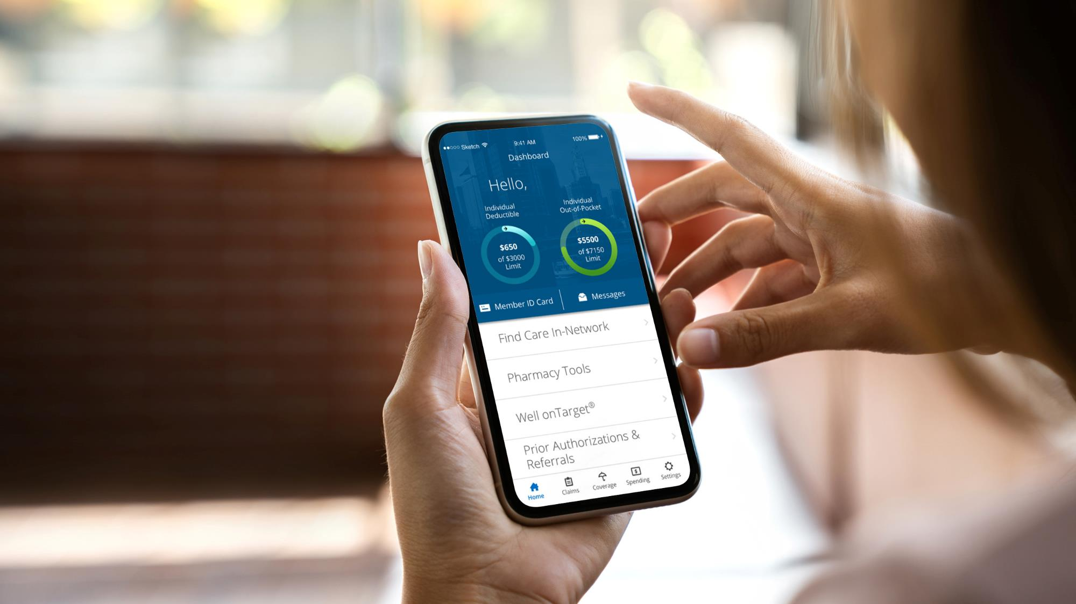

MOBILE APP
With the BCBSNM App,
you can manage your health care information whenever, wherever
To download, text
BCBSNMAPP
to 33633

Slide 17

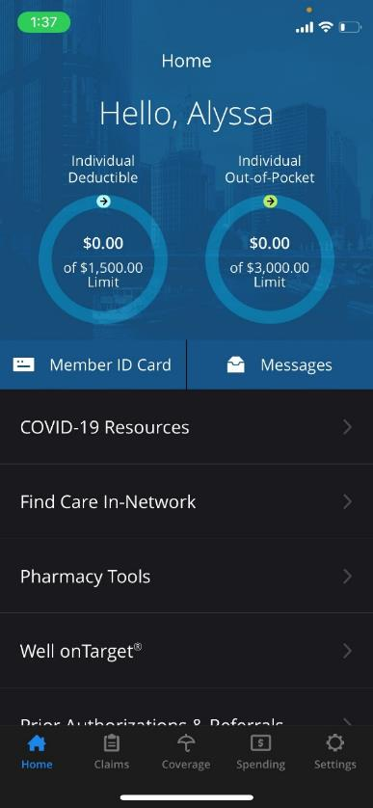
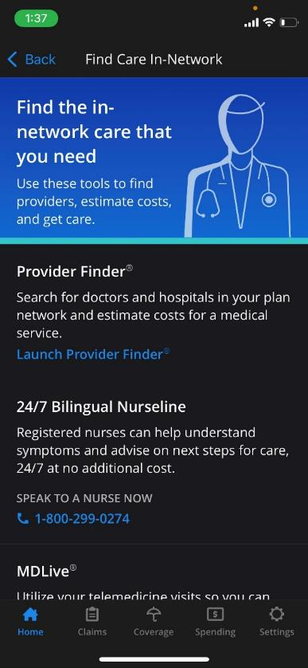
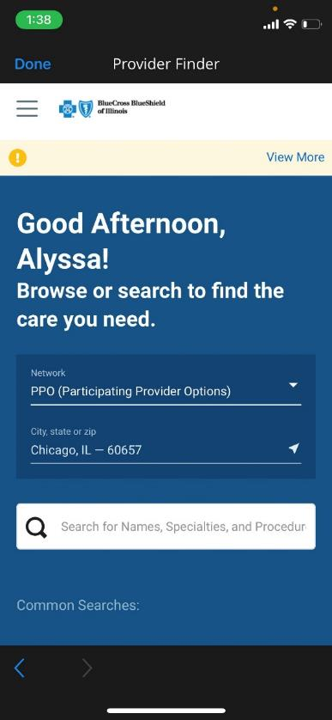

Slide 18

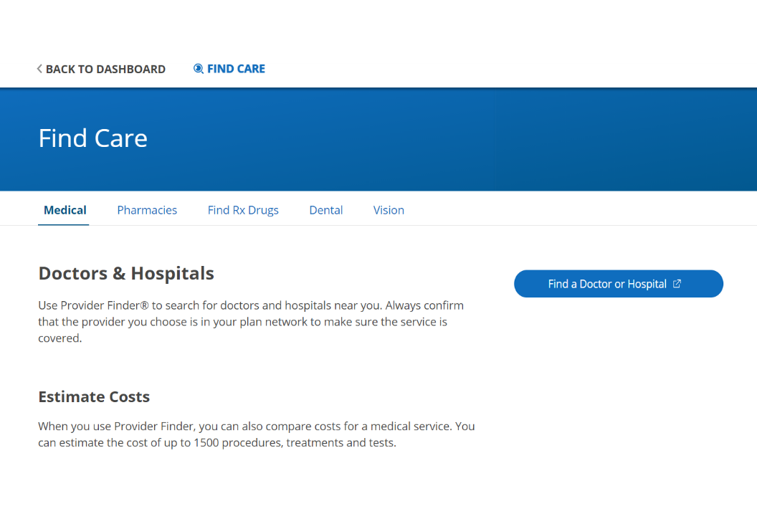
How to
Access
Provider
Finder®
Click on
Find a Doctor or Hospital

Slide 19
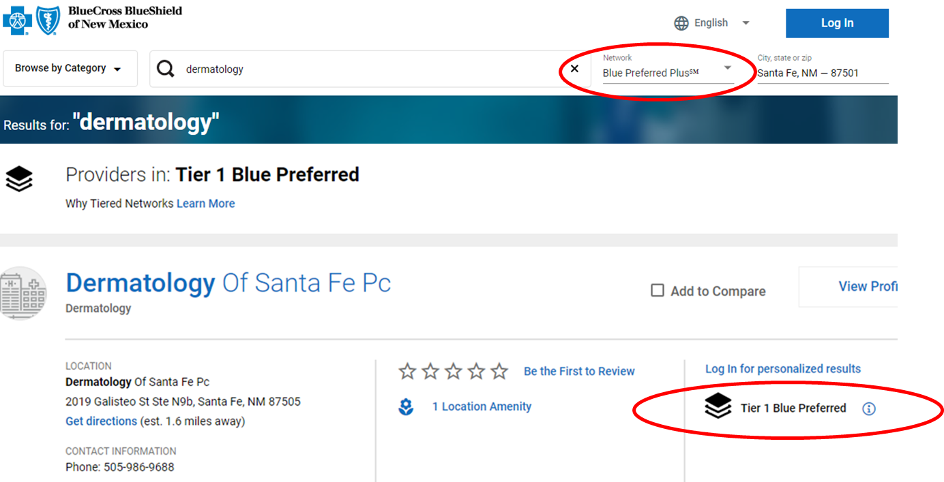
How To Find a PPO Tier 1 or Tier 2 Provider
JEFF K
Search under the Blue Preferred Plus Network (Tier 1) or the Preferred Provider Organization Network (PPO) (Tier 2)
Look for the Tier 1 indicator next to the provider entry

Slide 20
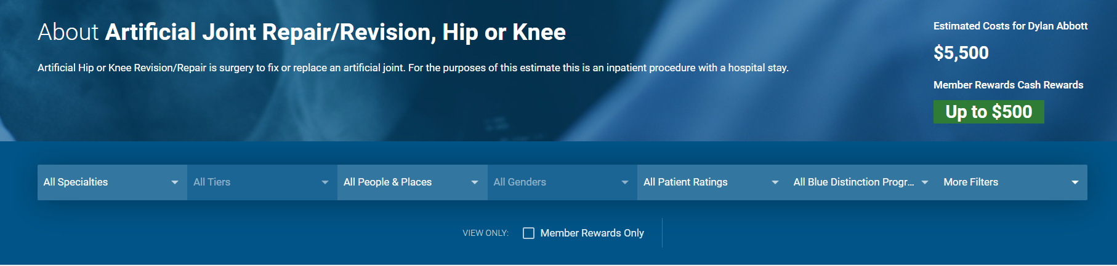
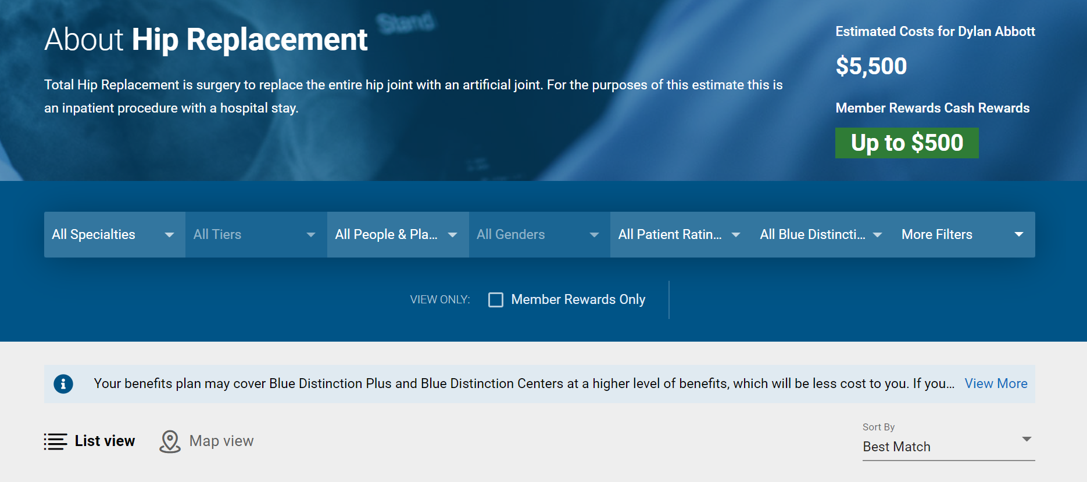

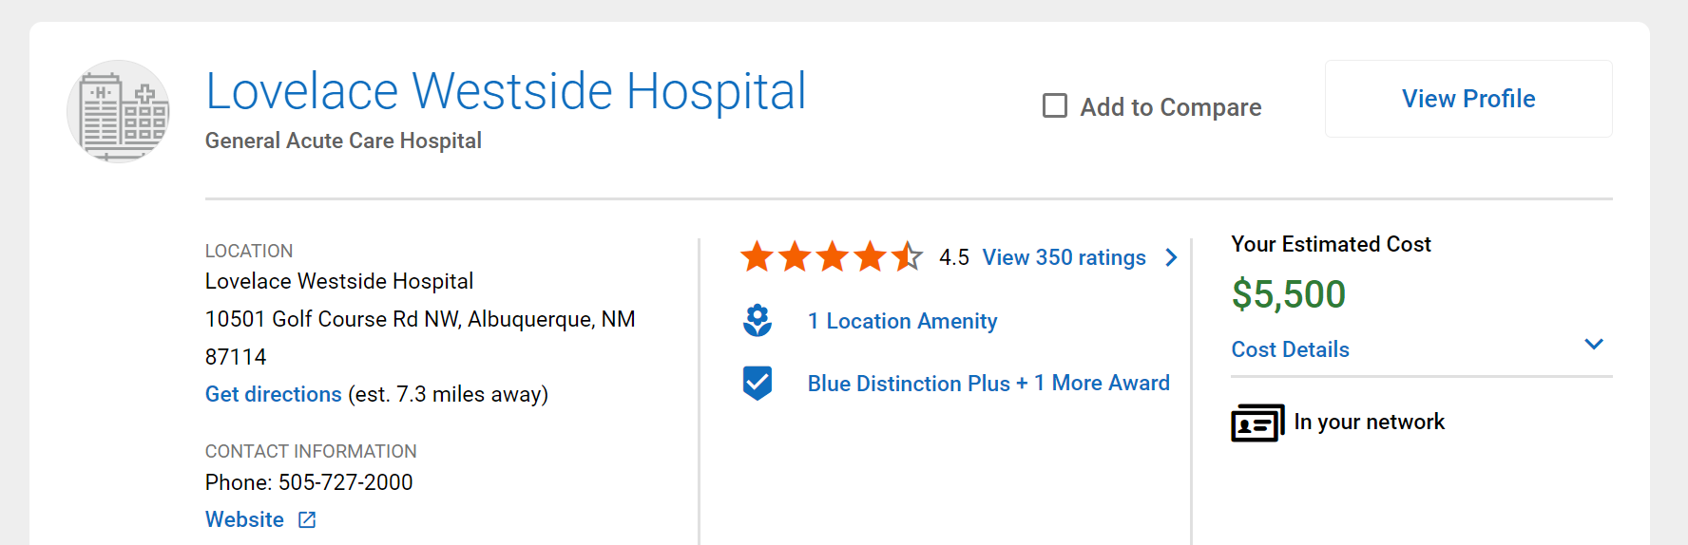
Cost Estimate Search Results
Did you know?
Cost Range for a
Knee Replacement
Description of procedure or service
Albuquerque, NM
$18,879 – $46,153
Compare
up to four
search results
View full cost
breakout of the procedure

Slide 21

Health and Wellness
JESSICA

Slide 22

LISA M
SAMI H
A HEALTH ADVISOR:
Can help to coordinate your and your family’s serious health concerns
Clinical nurse you can count on
when you need help the most
Works with a team of specialists to help make sure you have the right care for your unique circumstances
IF A HEALTH ADVISOR REACHES OUT…
Answer! Your health advisor’s goal is to help you get the care you need to get better.

Slide 23

24/7 Nurseline
AUDRA
Advice anytime.
Advice isn’t just needed from 9 to 5.
Round-the-clock health and wellness advice from licensed nurses
Plus, you can also listen to more than 1,000 health topics
800-973-6329
Available in English and Spanish

Slide 24

Digital Mental Health
LISA M
CHRIS S
Available to employees and their family members 13 years and older
Programs in English and Spanish
Personal coaching by phone, text or email
Online programs through Learn to Live at no added cost for:
Stress, anxiety and worry
Depression
Social anxiety
Insomnia
Panic
Substance use
Resiliency
Get started with a mental health assessment:
Log in to Blue Access for MembersSM
Choose Wellness, then find
Digital Mental Health
Learn to Live provides educational behavioral health programs. Members considering further medical treatment should consult with a physician. Learn to Live, Inc. is an independent company that provides online behavioral health programs and tools
for members with coverage through Blue Cross and Blue Shield of New Mexico. BCBSNM makes no endorsement, representations or warranties regarding third-party vendors and the products and services offered by them.
Notes:
Approved 06/24/24
EMI Team – Deborah Wells, Debb Bastian
Content approved by Emily Sen
Product SME: Jessica Doyle, Emily Sen

Slide 25
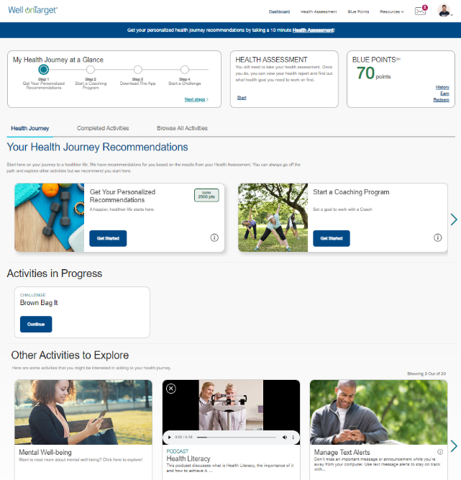
Member Wellness Portal
Portal Highlights
Health Assessment
Personalized “My Journey” member dashboard
Digital self-management programs Personalized “My Journey” member dashboard
Trackers and tools
“Explore” wellbeing resources
Coaching program*
Interactive symptom checker
Health and wellness content
Secured messaging
Blue PointsSM rewards*
Fitness Program
Tracking for fitness, nutrition and
device integration
Personal wellness challenges
Mobile app (AlwaysOn)
Health and Wellness content
JESSICA
ANGELICA
The portal includes recommended activities
that make up your Personal Member Journey.
May be included in other packages.
The Fitness Program is provided by Tivity Health™ Services, LLC, an independent contractor which administers the Prime® Network of fitness centers. The Prime Network is made up of independently-owned and managed fitness centers. Prime is a registered trademark of Tivity Health, Inc. Tivity Health is a trademark of Tivity Health, Inc.
Screen images are for illustrative purposes only.
*Blue Points program rules are subject to change without prior notice. Member agrees to comply with all applicable federal,
state and local laws, including making all disclosures and paying all taxes with respect to their receipt of any reward.
AlwaysOn is owned and operated by Onlife Health Inc. an independent company that has contracted with
Blue Cross and Blue Shield of New Mexico to provide digital health management for members with coverage through BCBSNM.
BCBSNM makes no endorsement, representations or warranties regarding third-party vendors and the products and services offered by them.

Slide 26
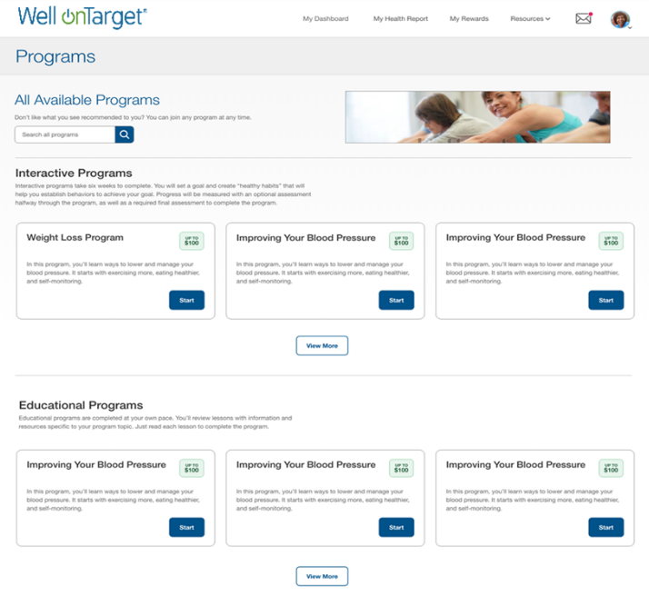
Wellness Information,
Right at Your Fingertips
JESSICA
ANGELICA
Digital self-management programs
on a range of wellbeing topics
Interactive
Enhancing your Physical Activity
Managing Your Stress
Improving Your Sleep
Living with Diabetes
Quitting Tobacco
Staying Tobacco-Free
Achieving Your Healthy Weight
Maintaining Your Healthy Weight
Nutrition for Better Health
Improving Your Blood Pressure
Financially Fit
Improving Your Oral Health
Educational
Managing Your Metabolic Syndrome
Preventing Diabetes
Healthy Bones and Joints
Living With Asthma
Living With Chronic Obstructive Pulmonary Disease (COPD)
Living With Congestive Heart Failure (CHF)
Living With Coronary Artery Disease (CAD)
Improving Your Cholesterol
Healthy Pregnancy
Preventive Health: Reducing Your Risks
Screen images are for illustrative purposes only.

Slide 27
BUILT-IN INCENTIVES
Blue PointsSM
Offerings that earn points:
Use of online trackers
Connecting and syncing a
fitness device or app
Health Assessment completion
Digital Self-management
Program completion
Fitness program visits
Redeem points in the online Shopping Mall with over a million products!
Blue Points Program Rules are subject to change without prior notice.
See the Program Rules on the Well onTarget Member Wellness Portal at wellontarget.com for further information.
27

Slide 28
Flexible Gym Network
JESSICA
ELLEN C
A choice of gym networks to fit budgets and preferences.*
Studio Class Network: Boutique-style classes and specialty gyms are pay-as-you-go with 30% off every
10th class.
Family Friendly: Expands gym network access to your covered dependents at a bundled price discount. Member pays only one enrollment fee per family.
Convenient Payment: Monthly fees are paid via automatic credit card or bank account withdrawals.
Selecting Options
You can select an option based on your preference. Once you pay, you’ll have access to all locations within the purchased plan and those at the lower price, too.
The Elite plan has the option to select one home elite gym and access to all other gyms.
You have the option to change your Elite home gym monthly.
Plan Options | Digital Only | Base | Core | Power | Elite
Monthly fee | $10 | $19 | $29 | $39 | $99
Gym* facility network size | Digital access only | 3,000 | 7,500 | 12,000 | 12,400
$19 initiation fee (no initiation fee for digital-only option)
*Represents possible network locations. Check local listings for exact network options as some locations may not participate.
Network locations are subject to change without notice.
Taxes may apply. Individuals must be at least 18 years old to purchase a membership.

Slide 29
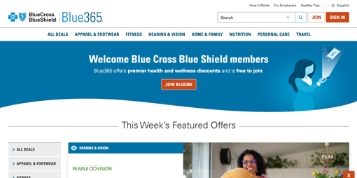


Blue365®
Member Discount Program
JESSICA
Member discounts simply for being a BCBSNM member
Exclusive health and wellness deals from national and local retailers
Save money on fitness gear, family activities, gym memberships, healthy eating, dental, vision, hearing aids and more from top national and local retailers
Go to www.blue365deals.com/BCBSNM to register, view your available discounts and
sign up for weekly emails
The relationship between these vendors and Blue Cross and Blue Shield of New Mexico is that of independent contractors.
Blue365 is a discount program only for BCBSNM members. This is NOT insurance. Some of the services offered through this program may be covered under your health plan. Employees should check their benefit booklet or call the Customer Service number on the back of their ID card for specific benefit facts. Use of Blue365 does not change monthly payments, nor do costs of the services or products count toward any maximums and/or plan deductibles. Discounts are only given through vendors that take part in this program and are subject to change. BCBSNM does not guarantee or make any claims or recommendations about the program’s services or products. Members should consult their doctor before using these services and products. BCBSNM reserves the right to stop or change this program at any time without notice.
BCBSNM makes no endorsement, representations or warranties regarding third-party vendors and the products and services offered by them.
Screen images are for illustrative purposes only.
Notes:
Approved 07/09/24
EMI Team – Deborah Wells, Debb Bastian
Content approved by Cora Weisenberger
Blue365 member discount program. Simply for being a Blue Cross and Blue Shield of New Mexico member, you will be able to receive exclusive health and wellness deals from national and local retailers to help keep you healthy. Save money on health care products and services that are not always covered by your benefit plan such as gym memberships, vision exams and services, hearing aids, fitness devices and diet-related services.
Log on to Blue Access for Members and under the Member Services tab you'll find updates on the discount program. From your BAM home page, you can access the Blue 365 Member Discount Program from the Wellness menu (under My Health).

Slide 30

Women’s and Family Health
SONYA
No matter what stage you are at in life’s journey, you should prepare as much as you can. We have tools to help — at no extra cost to you.
Ovia Health™ apps are your companion for the journey ahead: from cycle and fertility tracking to pregnancy, parenthood and menopause.
Well onTarget® offers self-guided courses that
help you plan for a healthy pregnancy and baby.
Plus, if your pregnancy is high-risk, BCBSNM will provide support from maternity specialists to
help you care for yourself and your baby.
Prepare for your life-changing journey.
Ovia Health is an independent company that provides maternity and family benefits solutions for Blue Cross and Blue Shield of New Mexico.
BCBSNM makes no endorsement, representations or warranties regarding third-party vendors and the products and services offered by them.

Slide 31


Getting a Health Checkup
Has Never Been Easier.
Notes:
Good Morning everyone and thank you for joining us today!
My name is Oscar Perez and I will be the Client Success associate managing your account.
This will be my 2nd year with Catapult Health, were I originally started as a Supply chain specialist facilitating our National Logistics network.
My responsibilities include leading the implementation process, providing daily support, best practices, offering reporting insights, and providing marketing support to ensure the smooth operation of your program.
*Lets have a brief pause for introductions*

Slide 32

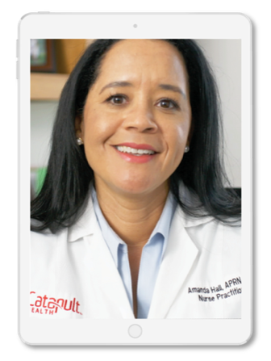


What’s in it for participants?
ACCESSIBLE
CONVENIENT
SAFE
EMPOWERING
Virtual Video Consult
with a Board-Certified
Nurse Practitioner
VirtualCheckup® By Request
Testing results discussed & Personal Action Plan created
Referral into optimal health improvement programs
VirtualCheckup® Onsite
Results transmitted to participant’s PCP, same day and at no charge
Follow-up touch points with high-risk participants
Notes:
Both services provide a safe, fast and convenient option that serves as an alternative to a normal doctor visit, especially to those who may not have a primary care physician or may be experiencing a lapse in treatment.
Our services may allow participants to receive medical counsel at an expedited pace considering that choosing an in-network physician, as well as scheduling an appointment can be an arduous task at times.
The virtual consultation can be done in the comfort of your own home, skipping reception at the doctor's office as well as lengthy wait times.
NP’s will explain your Blood Panel Results and discuss a Personalized Action Plan tailored to your health.
Referrals into health improvement programs may be recommended based off findings and results are sent to each participant's smartphone and to their PCP if the
Those without a PCP will be assisted in finding one for preventative and continued care.

Slide 33

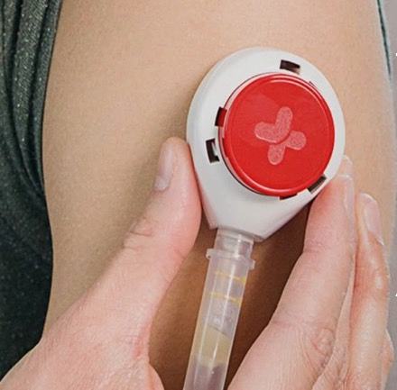


VirtualCheckup® By Request
The Participant Experience
1
2
3
4
5
Employer and Plan
Sponsored Programs
Health Coaching
Diabetes Management
Behavioral Health
Primary Care Provider
Health Plan
EAP
Register
for Your VirtualCheckup®
It takes less than
2 minutes on your smartphone or laptop.
Quick and Easy Blood Test, Blood Pressure Check
Catapult’s at-home blood collection device is quick, diagnostic, and virtually painless.
Schedule Virtual NP Consultation when Convenient
Completed on your device, and at a time you choose.
Live Video
Consult with a
Nurse Practitioner
Review your test results and receive your Personal Action Plan!
Referral into Employer and Plan Sponsored Programs
We drive your employees into your health improvement programs.
33
Notes:
Users signup for a checkup by utilizing a unique registration link that Catapult creates for your members. Registration can be accomplished from any computer, tablet, or smart phone and does not require the creation of a username or password. Based on which service method the member chooses, they will either receive a home kit in the mail, attend a worksite event, or swing through a Quest patient service center to complete their blood work and physical measurements. In either case, users will conclude their checkup with a live secure video consultation with a board-certified Nurse Practitioner.
Catapult's Virtual Checkup process includes automated confirmation and reminder notifications that guide users through the experience to ensure they are engaged throughout the process. We are proud to report industry-leading completion and engagement metrics in Virtual Checkup with 86% of those who register taking action quickly and returning their sample within 15 days! On average, members take about 30 days to complete the process, start to finish.
Additional Information id needed:
For Virtual Checkups, the patient self-collects biometric data and a blood sample and submits them with a release form through the mail. When the sample has been processed, the patient receives timing options for a consultation with a Catapult Nurse Practitioner. The patient's secure link to their consultation arrives at their scheduled appointment time, where they are greeted by a brief video introduction to the Catapult Checkup. At this time, the patient completes a medical history questionnaire on their device. All results are immediately uploaded into our proprietary Electronic Medical Record (EMR), interpreted and prioritized using AI and Machine Learning, and transmitted to the Catapult Nurse Practitioner for review.
For on-site Checkups, the patient arrives at their scheduled appointment time where they are greeted by a Catapult Health Technician who collects a blood sample via fingerstick and other biometric measurements. At this time, the patient also completes a medical history questionnaire on one of our touch screen clinic laptops (about a 20 minute process in total). All results are immediately uploaded into our proprietary Electronic Medical Record (EMR) and an individual Personal Health Report is generated electronically.
Additional onsite checkups, Catapult offers a variety of team sizes ranging from 25 to 60+ appointments per event day. The amount of Catapult clinic staff onsite depends on the team size (ranges from 2 - 4+ staff). Additionally, our Nurse Practitioners are located in our Texas-based headquarters where they are connected to patients via a secure video conferencing platform. Catapult can see 5 – 10+ patients per hour and typically has 4 – 7+ team members dedicated to serving patients at each individual clinic. In certain circumstances, Catapult can scale up from this model to accommodate a larger team size where we can see a higher number of patients per hour per day. A Catapult Health Technician will guide the member through the collection of the blood work, physical measurements, and personal health history questionnaire. Results are processed in real time at which point, the member will have a live video consultation over their results in a private area with a Catapult licensed Nurse Practitioner. Virtual Checkups are performed digitally from the comfort and safety of the members' home at a time that is convenient for them
Local Lab: Catapult partners with Quest Diagnostics for lab-based Virtual Checkups. All checkup patients then receive a private consultation with a Catapult Nurse Practitioner via video conferencing technology where results are reviewed, and action plan is created, and the patient is connected into the next point of care (about a 10 minute experience in total). The patient’s results, action plan and audio recap are loaded into the secure patient portal and can also be sent to their smartphone. Results can also be sent via secure eFax to their PCP or we can help them find a new in-network PCP if patient does not have one.

Slide 34

Women’s and Family Health
Prepare for Your Life-Changing Journey
Whether you are pregnant or planning to get pregnant, you should prepare as much as you can. We have tools to help you — at no extra cost to you.
Ovia Health™ apps are for tracking your cycle, pregnancy and baby’s growth.
Well onTarget® offers self-guided courses that help you plan for a healthy pregnancy and baby.
Plus, if your pregnancy is high-risk, BCBSNM will provide support from maternity specialists to help you care for yourself and your baby.
Ovia Health is an independent company that provides maternity and family benefits solutions for Blue Cross and Blue Shield of New Mexico.
34
Notes:
Next we will discuss how BLBSNM can help with Women’s and Family Health and prepare for your life-changing journey.
Whether you are pregnant or planning to get pregnant, BCBSNM has tools to help you – at no extra cost to you.
Ovia Health apps are for tracking your cycle, pregnancy and baby’s growth. Each app has videos, tips, coaching and more.
Ovia Fertility helps you track your cycle and predict when you are more likely to get pregnant.
Ovia Pregnancy helps you track your pregnancy and baby’s growth week by week leading up to your baby’s due date.
Ovia Parenting helps track your child’s growth from birth through three years old.
Well onTarget® has self-guided courses about pregnancy that you can take online, covering healthy foods, body changes, labor and more.
Plus, if your pregnancy is high-risk, BCBSNM will provide support from maternity specialists to help you care for yourself and your baby.

Slide 35

WondrTM
JESSICA
MELISA D
Metabolic Syndrome Reversal Program
With Wondr you can lose weight, gain energy, sleep better and improve your mind and body - all while eating your favorite foods
Online program and mobile app allows members access anywhere at any time
Wondr is a skills-based digital weight loss program that teaches you how to enjoy the foods you love and improve
your overall health
Your employer has partnered with Wondr Health to help
you improve your overall health at no cost to you.
Wondr Health is an independent company that that has contracted with Blue Cross and Blue Shield of New Mexico to provide a metabolic syndrome reduction program for members with coverage through BCBSNM.

Slide 36
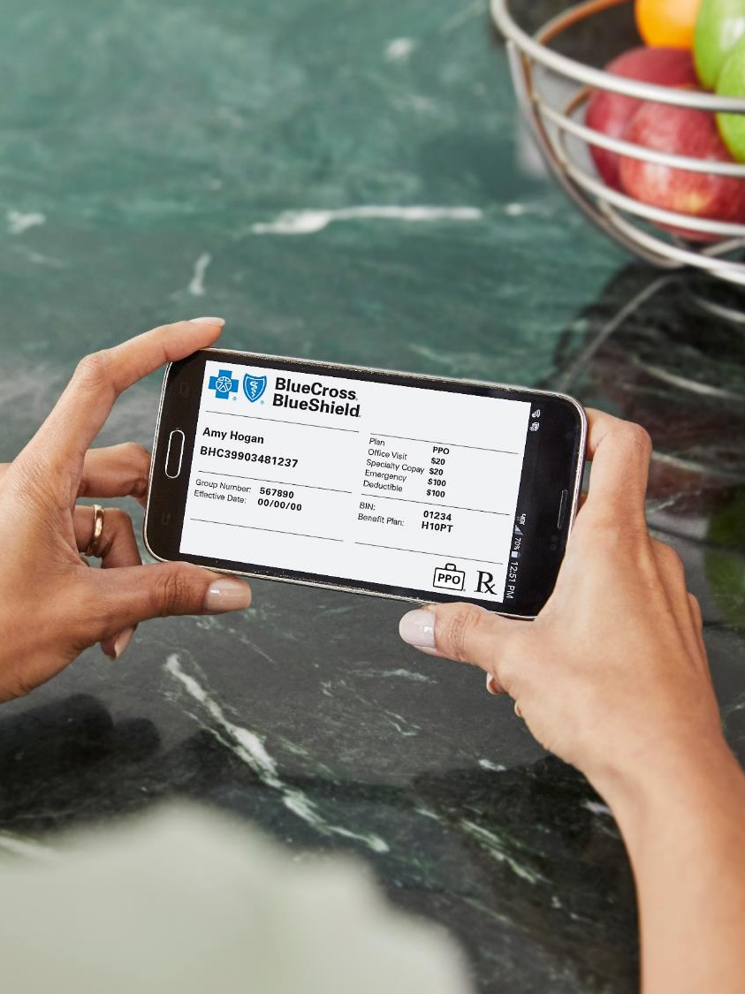
Stay Engaged in Your Health Care
JEFF K

Slide 37

How You Can Be a Smarter Consumer
JEFF K
Use in-network providers
Research costs in Provider Finder®
Review EOBs and bills sent by your providers
Use wellness benefits
See your physician regularly for preventive care or illness
Ask your health care provider questions about prescribed medications and treatment
Ask your doctor if lower-cost drug options are right for you
Visit bcbsnm.com for more health and wellness information

Slide 38

Blue Cross and Blue Shield of New Mexico
Member Customer Service for the State of New Mexico
877-994-2583

